Slide 1
Working With Legislation
Bryan Evans – Executive Director
North Carolina Association of Soil and Water Conservation Districts

Slide 2
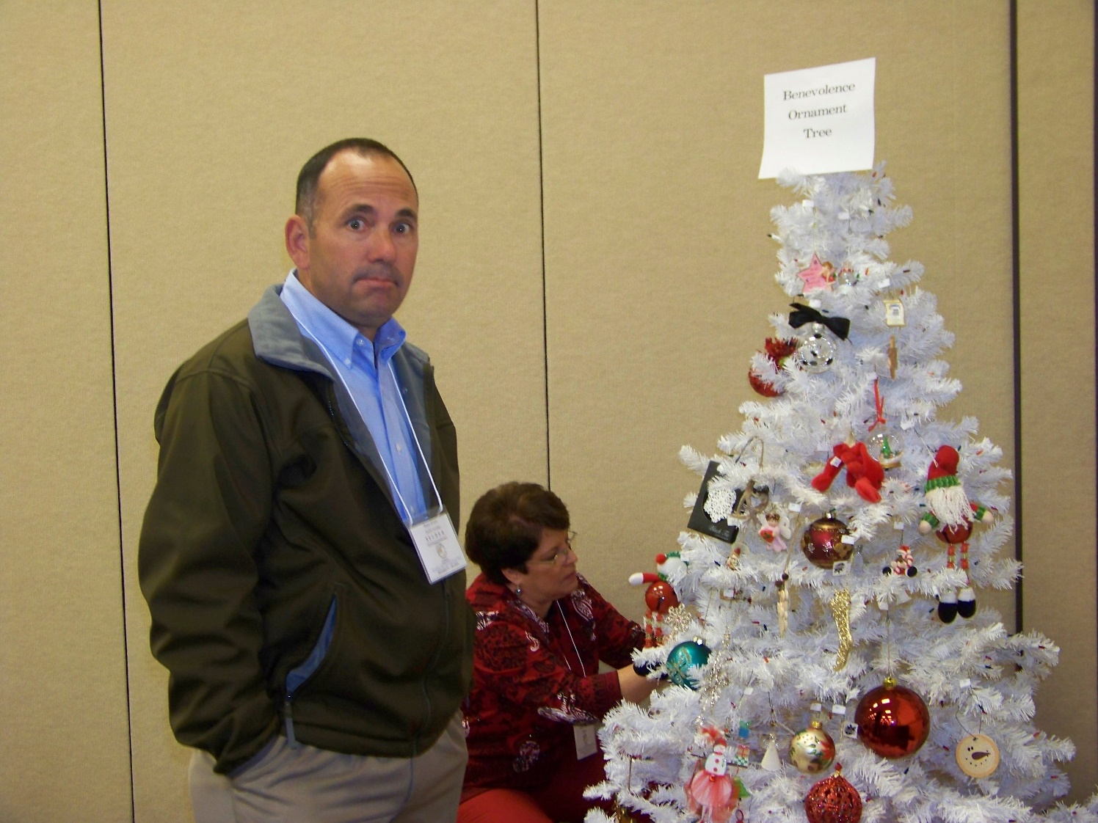
Who Am I?

Slide 3
It is an important roll of the Conservation Districts to influence policy
Notes:
CDs are entities of government
Supervisor are public officials originally and still empowered to lead a locally lead conservation program
Most rules are a direct result of legislation (rules are usually required when legislation/laws affect citizens
Districts should in touch with the local needs
‘Local Workgroups are invaluable in developing the priorities of landowners and users
New laws and changes in existing ones may be a part of the process

Slide 4
Policy is developed to address concerns or issues of landowners and land users as well as the Conservation District
Notes:
Local Districts, working through a statewide approach can have significant influence on legislation
Legislators care a lot about what their constituents are saying. They are the ones who fund the campaigns and parties
Supervisors working directly with their local legislator has a big impact
On the national level, many times you have to enter your zip code the email a member of Congress

Slide 5
The Resolution process is the most effective means to develop policy and legislation
Notes:
As I mentioned, many times when there is a problem, there is just complaining
I have told folks before, if there is a problem, put into a resolution our State Association and we have to debate it
In NC, we have 8 committees set up that address resolutions in committee, then send to the body for debate and vote
Some are scared of writing resolutions because they are typically in a format that we don’t use for a lot of other things

Slide 6
WHEREAS; the Soil and Water Conservation Districts (Districts) nationally were formed to provide locally lead conservation to landowners and land users, AND WHEREAS; Soil and Water Conservation Supervisors (Supervisors) are selected within their respective Districts by citizens to serve in a capacity that directs conservation ……. THEREFORE LET IT BE RESOLVED; that the NC Association of Soil and Water Conservation Districts supports that Supervisors for North Carolina always serve as non-partisan elected and appointed positions.
Notes:
There are 2 parts to a resolution
The Whereas’s and the Be It Resolved
The Whereas’s is the purpose for the resolution
This part should encompass the reason and the need for the action
It should be able to taken by someone who is not aware of what is needed, and interpreted to determine it’s need and purpose
Then the Whereas’s should say specifically what action is needed to address the issue
It needs to be specific
If someone else is handed this resolution (such as NACD legislative team) they need have a clear direction to pursue
We have had an issue in the past with some legislation that got passed, but wasn’t exactly what we had sked for
Supervisor training

Slide 7
What is Lobbying? : seek to influence (a politician or public official) on an issue.
Notes:
So once the direction is set, there needs to be champions
Part of the champions need to be influential within or connected with your Districts
Supervisor, State Association and partners are vital this
Lobbyist are a common use as
These people develop relationships on a broader basis by being engaged in the legislative
As a government employee, it is a violation of law to be engaged in lobbying
If you are talking in generalities, it is not lobbying
If you are talking about a specific piece of legislation, it is
Supervisor are able to lobby as a volunteer without being registered
501 (h) election should be filed with the IRS as a non-profit

Slide 8
It’s not what you know;
It’s not who you know;
It’s who knows you
Notes:
I know President Biden, but he has no clue who I am

Slide 9
It’s vitally important to know what you are asking for
Notes:
Quick and specific

Slide 10
Remember the Golden Rule
“The person with the gold makes the rules”
Notes:
Everyone needs to know too, that unless you have a lot of influence (and money), threats of voting for someone else doesn’t far except backwards
Heavy handedness doesn’t work well many times
Also remember that there could adverse affects somewhere else
You get what you are asking for, but the process hurt a partner
Legislators can have a tendency to move money

Slide 11
Whitepapers are usually requested
Notes:
Be prepared to hand a whitepaper
A lot of times, we don’t ever see the actual legislator, it is staff member
They are busy and can’t retain everything we can spew at them in the time we have with them

Slide 12
Always be prepared with an elevator speech
Notes:
It is a good practice to have quick 30 sec commercial in your mind
Many meetings may occur in town, in the halls of the general assembly or in the elevator and they can’t leave

Slide 13
EXERCISE

Slide 14
REPORT OUT

