Slide 2
Southeast Conservation district employees association 2022 SECDEA Annual Conference November 8th – 9th, 2022
Renita (Shorty) Beaty
Hamilton County Soil & Water Conservation District
Chattanooga TN

Slide 3
Tennessee Agriculture Literacy Week will be celebrated November 13 – 19, 2022
More info can be found at….
https://tnfarmbureau.org
And
www.tennesseeag.org

Slide 4
“Studies show the single biggest predictor of high academic achievement and high ACT scores is reading to children”
TN Ag Literacy Week is usually the week before Thanksgiving where those involved in Agriculture and Conservation are encouraged to visit their local schools to read accurate agriculture themed books and interact with students and teachers. With an increasingly urban population and fewer people raised on farms, most of today’s students do not know where their food and fiber comes from….

Slide 5
“The more that you read, the more things you will know. The more that you learn, the more place you will go” - Dr Seuss
“Not all readers are leaders, but all leaders are readers.”
- Harry S Truman

Slide 6
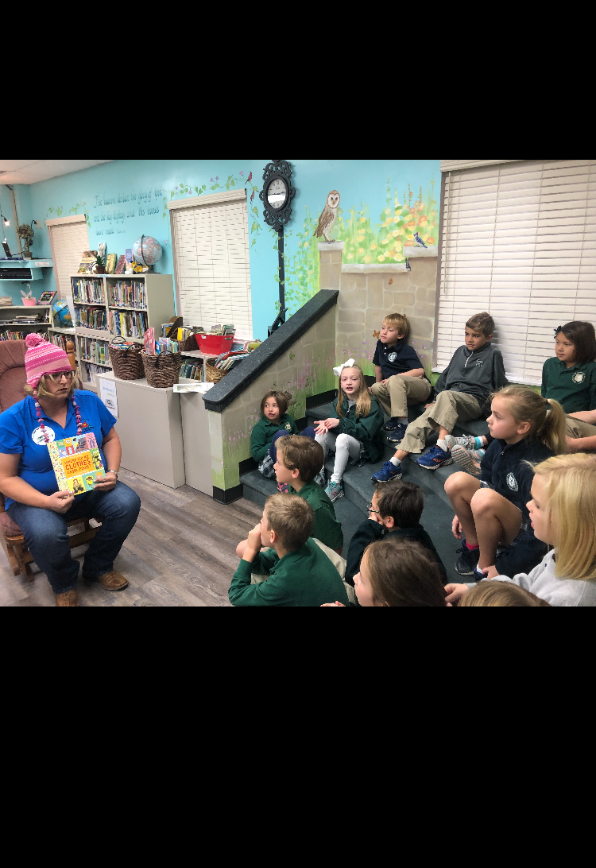
“Reading is to the mind what exercise is to the body” - Richard Steele Use props when reading, anything for the students to see or feel… Just makes it more fun! Don’t be bashful Step outside your comfort zone

Slide 7
“A book is a gift you can open again and again” - Garrison Keillor When using props make it educational…. This is cotton, I used it while reading the book, Where did my clothes come from? By Chris Butterworth Illustrated by Lucia Gaggiotti

Slide 8
“A book is a gift you can open again and again” - Garrison Keillor When using props make it educational…. This is cotton, I used it while reading the book, Where did my clothes come from? By Chris Butterworth Illustrated by Lucia Gaggiotti
SOME FAVORITE BOOKS I LIKE TO READ
“How did that get in my Lunchbox?” by Chris Butterworth
*American Farm Bureau Foundation Book of the Year
“Where did my clothes come from?” by Chris Butterworth
“Who grew my soup?” by Tom Darbyshire
*This book was underwritten by Campbell Soup Company, in hopes that children of all ages will learn to love to eat their vegetables.

Slide 9
“A book is a gift you can open again and again” - Garrison Keillor When using props make it educational…. This is cotton, I used it while reading the book, Where did my clothes come from? By Chris Butterworth Illustrated by Lucia Gaggiotti
MAKE SURE YOUR BOOKS ARE AGRICULTURE ACCURATE
Good sources for reading materials –
American Farm Bureau Foundation – www.agfoundation.org or www.fb.org
Contact your local Farm Bureau office in your County in your State
Lots of County Farm Bureau offices have their own Ag Literacy library
and will let you borrow books.
Contact the Ag in the Classroom/AITC Representative in the State/Corporate Office for Farm Bureau in your State – they sometimes have extra books from previous AITC workshops or trainings and will give them to you.

Slide 10
Thank you
Renita (Shorty) Beaty
renita.beaty@tn.nacdnet.net
Hamilton County Soil & Water Conservation District
Chattanooga TN

