Slide 2
Pollinator Bingo & Guide
Share Fair-2023-Tennessee​
Washington County SWCD

Slide 3
Introduction
Washington County Soil and Water Conservation District works with several different organizations to invest in pollinator Education. The TACD Category 2 Educator of the Year, Seed Keepers Forest School, was a great place for us to demonstrate these. We also have gotten to use them at some homeschool events and also at summer school events.

Slide 4
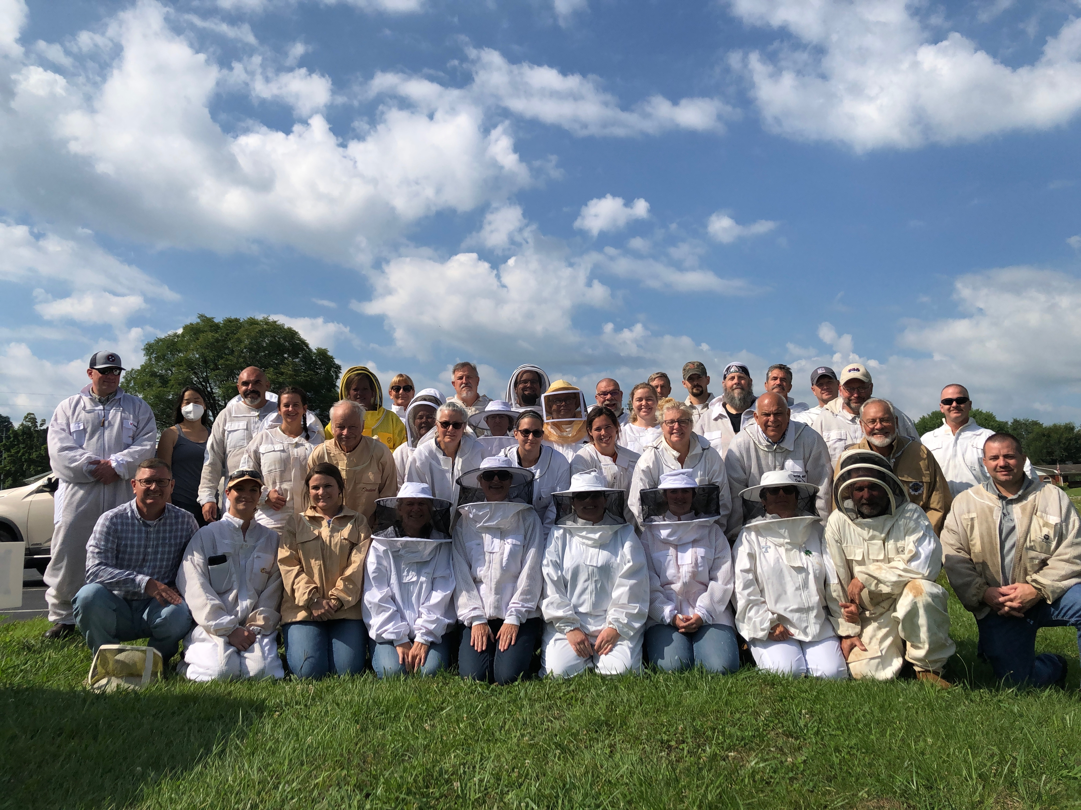
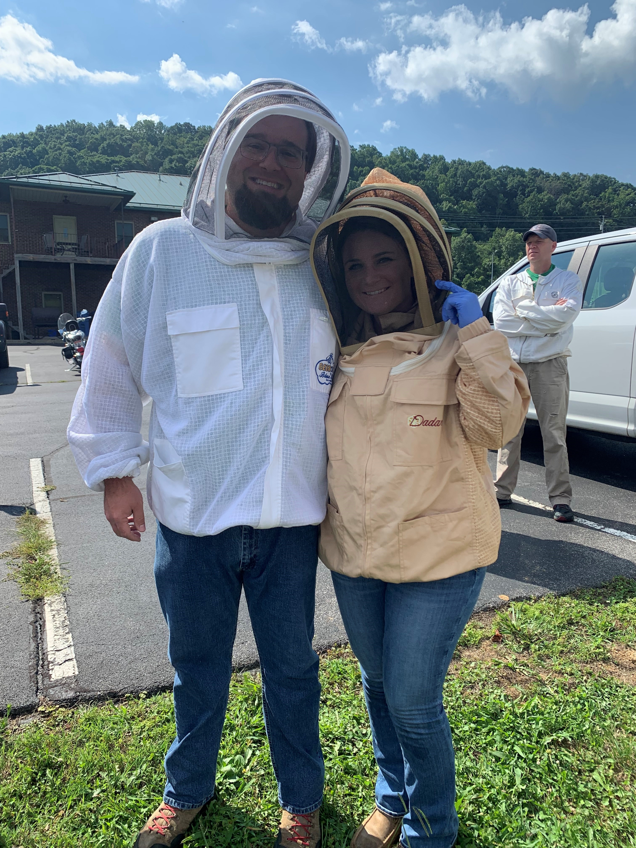
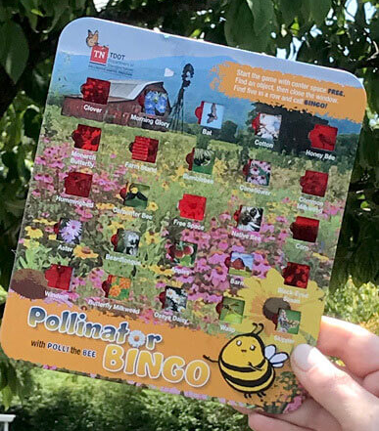
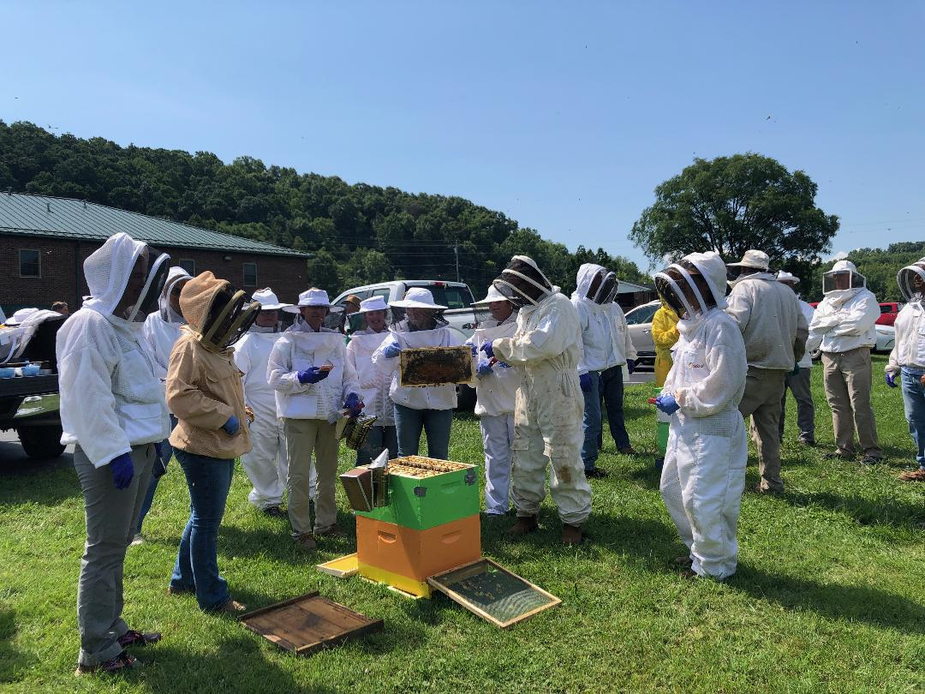
How to Play?
We use them and do a “nature walk” and when someone sees an item on the card, they call it out and we all cover the item.

Slide 5
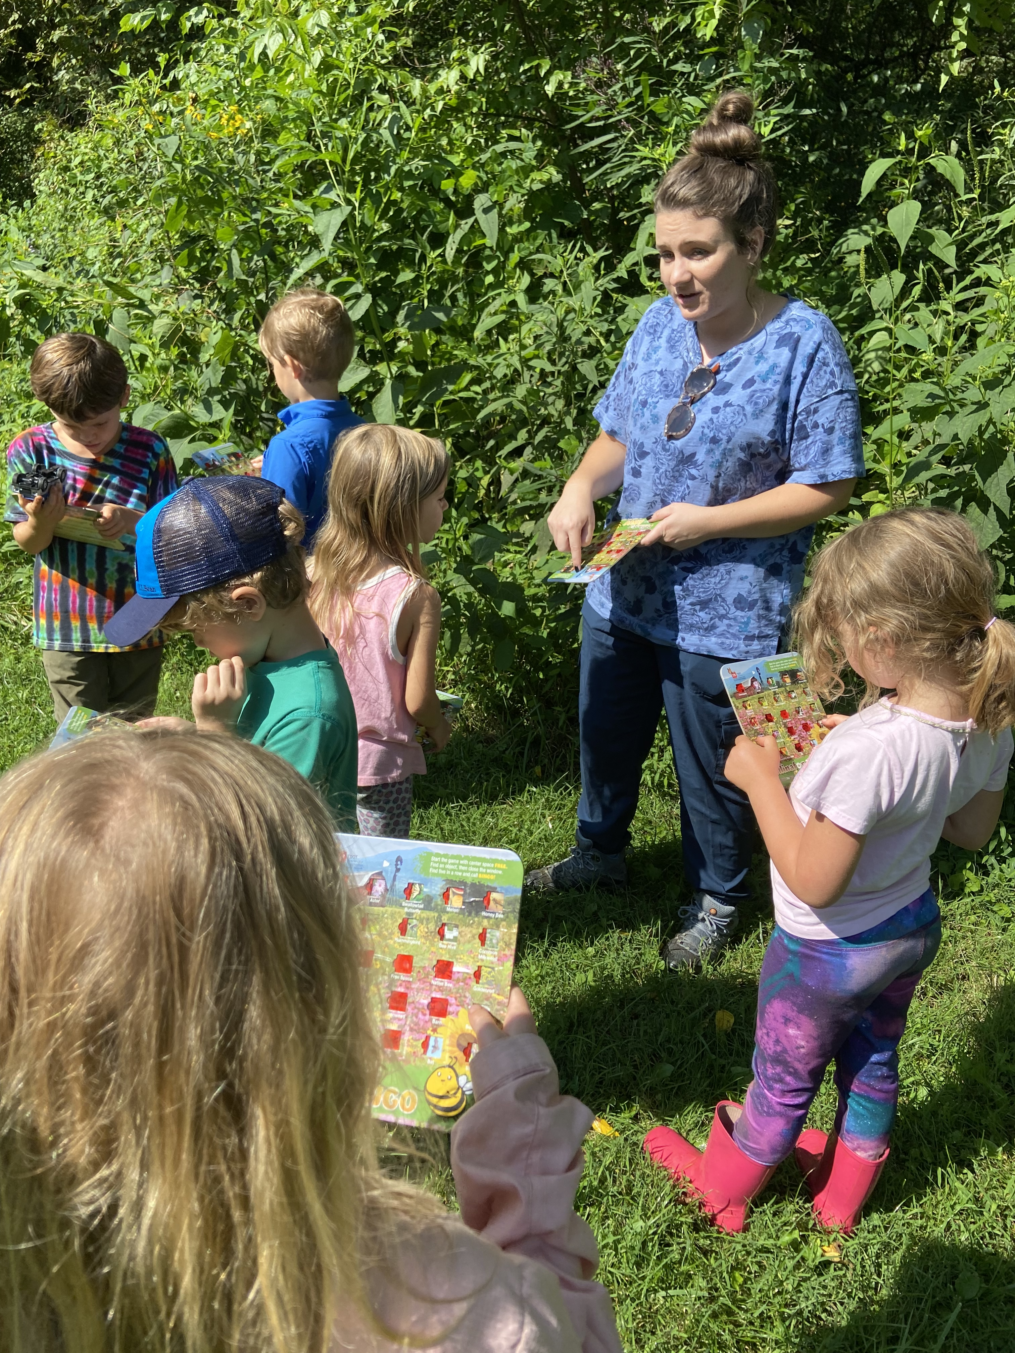
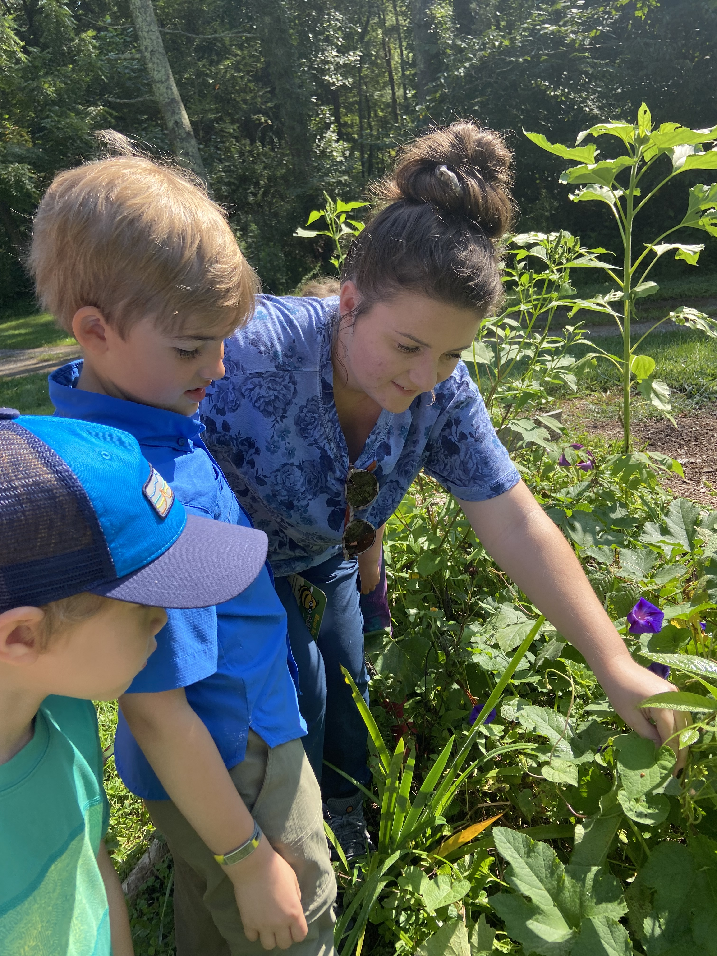
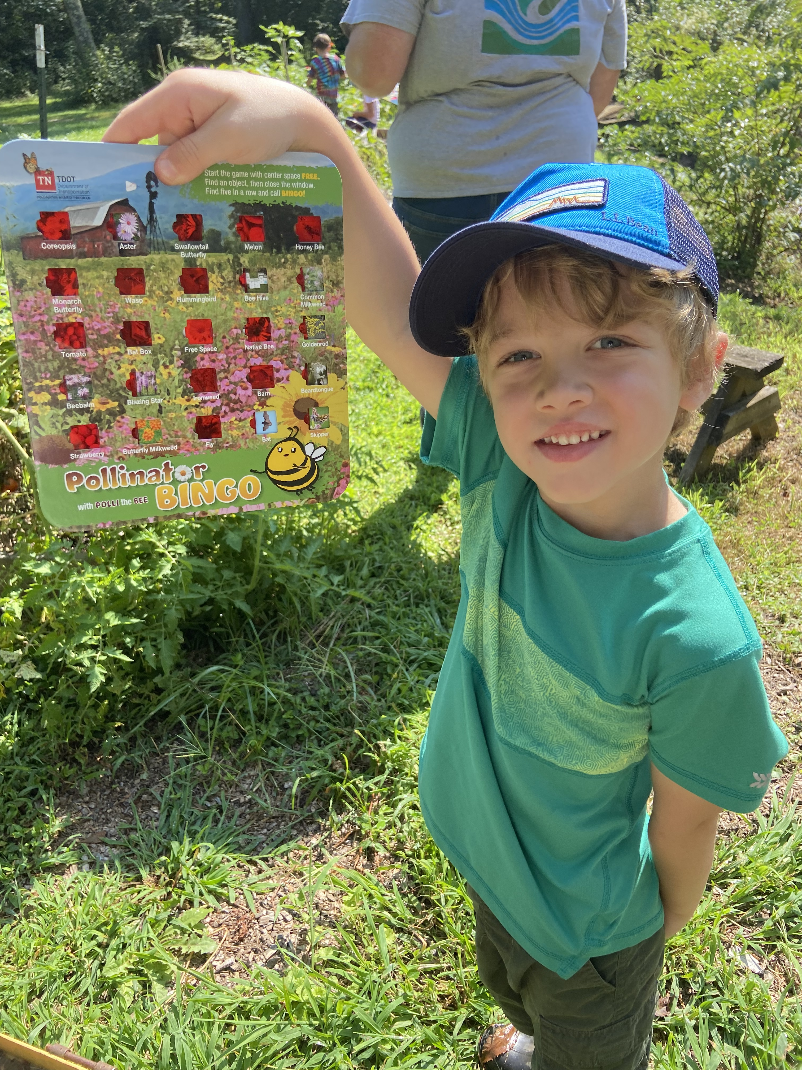
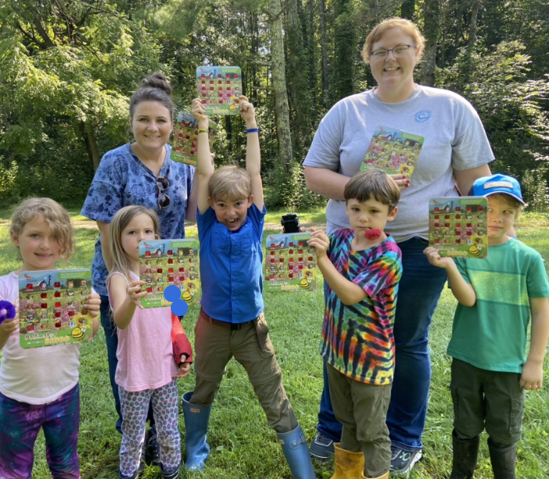
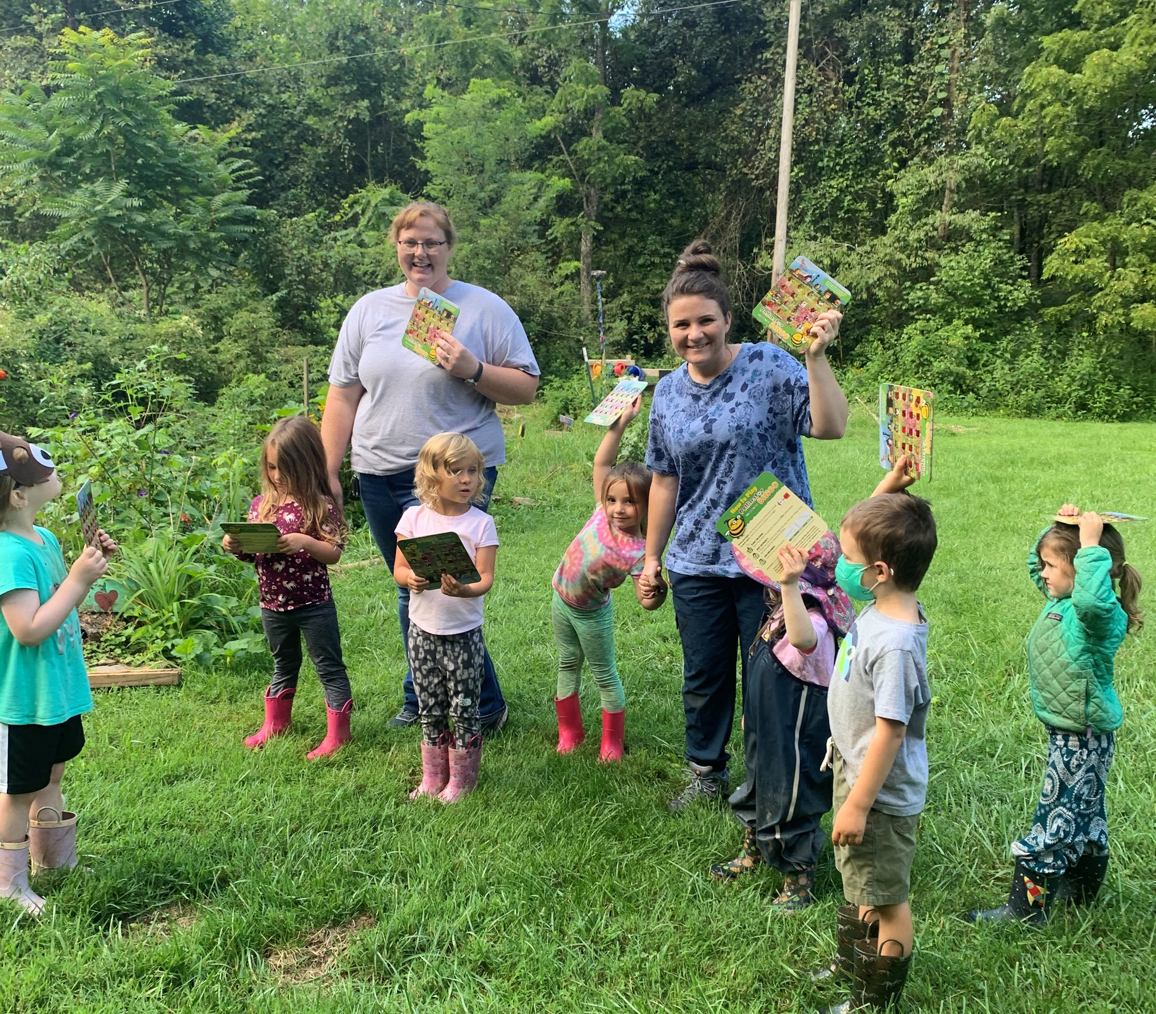
Pollinator Bingo!

Slide 6
We are going to play Pollinator Bingo
Please look in your bag and you will find your card!
You are going to get up and interact with your fellow District Employees
Look on the back of your cards and try to create a “Bingo” by talking to your fellow employees. In order to claim a space, you must ask the person their name, and where they are from!
LETS BEGIN!

Slide 7
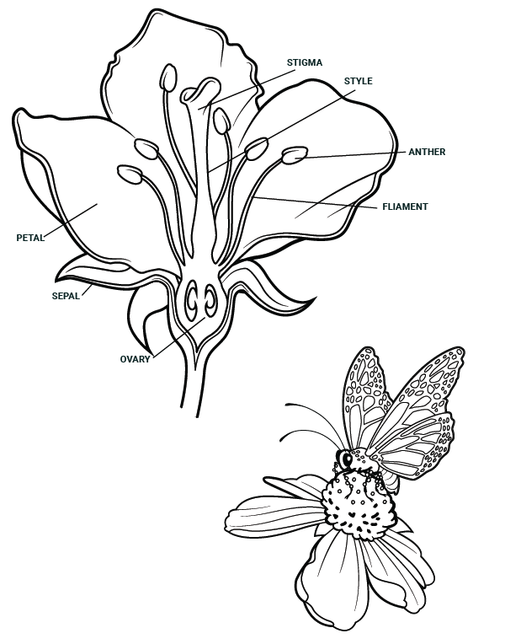
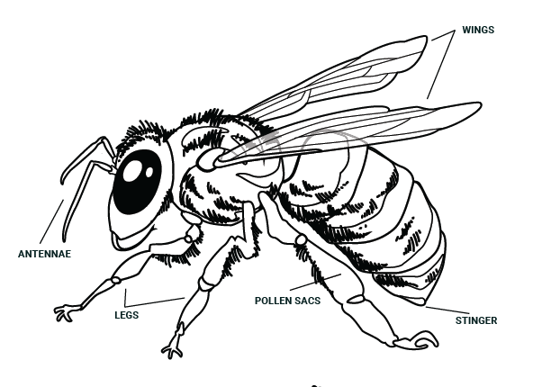
NACD Pollinator Guide-Available on NACD Website-Will Also Email copy of the PDF
Has the learning standards and other ideas for a pollinator field day and activities

Slide 8
Educational Materials
Pollinator Habitat Program Websites
*NACD Pollinator Field Day Guide
*Pollinator Habitat Program:
https://tnpollinators.org/meetpolli/
*TDOT's Pollinator Habitat Program - TDOT Pollinator Habitat Program (tnpollinators.org)
This website has the TN Educational Standards and lessons
Pollinator.org

Slide 9
Free Seeds!
Project Milkweed has program resources and free seeds for the monarch butterfly
https://tnpollinators.org/milkweed/#planting

Slide 10
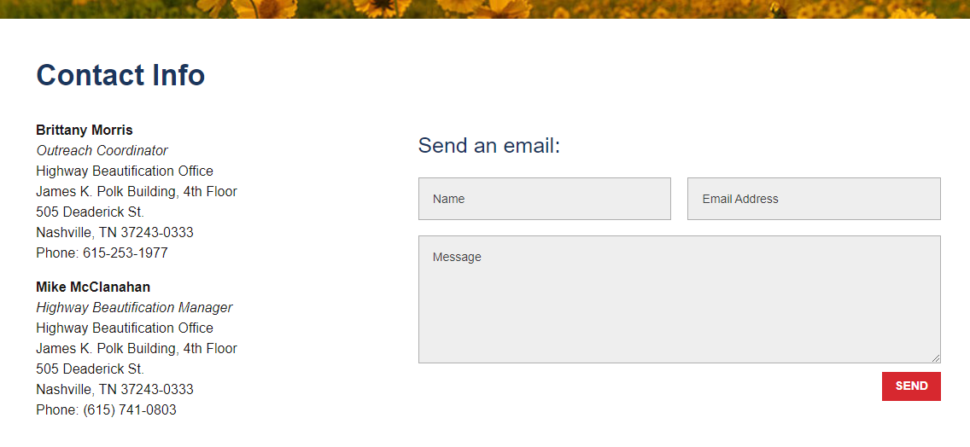
https://www.wildlifecenter.org/pollen This will link you to a printable pollinator bingo card
How to get your Pollinator Bingo Cards if you are in TN

Slide 11
https://www.pollinator.org/pollinator.org/assets/generalFiles/NAPPC.Monarch.broch.Aug.2019.hiRes.pdf

Slide 13
Posters available in the Back
You will also find seed packets from Eden Brothers and Bamert seeds in your envelopes.
WE ARE SUPER GRATEFUL FOR THEIR SPONSERSHIP OF SENDING US SEEDS!

