Slide 1
Composting in the classroom
Diane Curlee
Education Coordinator
Orangeburg County SWCD, SC

Slide 2
Materials 2 Liter Bottles Scissors Duct Tape Soil Vegetable Scraps Newspaper strips Water

Slide 3
Prepare the Bottle

Slide 4
Select a Container
Clear
Size
Notes:
Removable lid
Removeable label
2 Liter is best
1 Liter will work

Slide 5
Choosing the container.
Volume
2 Liter Soda Bottles - Best
2-quart juice container
will work
Notes:
Volume - more important than the shape.

Slide 6
Prepare the Container
Make Air Holes.
Compost needs air.
Notes:
Keeping lid and label on the bottle during this process makes this
step easier.
Middle School and up may use scissors to make holes.
Ag Classes may use Awls or nails.
Adjust depending upon the age group.

Slide 7
Prepare the Container
Make holes in the top ¼ of the container, near the lid.
6 holes
Keep the holes above the label.
Notes:
Use an awl (safer than an ice pick) to make holes in the top ¼ of the container, near the lid.
About 6 holes should be enough.
Keep the holes above the label.

Slide 8
Prepare the Container
Mark the top of the label to use as a guide.
Remove the label.
Notes:
Mark the top for cutting.
Use a maker to mark the top of the label. Put two dots about an inch apart on the back where the label makes a seam.
Remove the label.
Easy way – find the seam and let this be the back. Turn to the front. Cut the label from bottom up in the front.
Using the two sides, pull to the back. The label should come off with almost no residue left on the bottle.

Slide 9
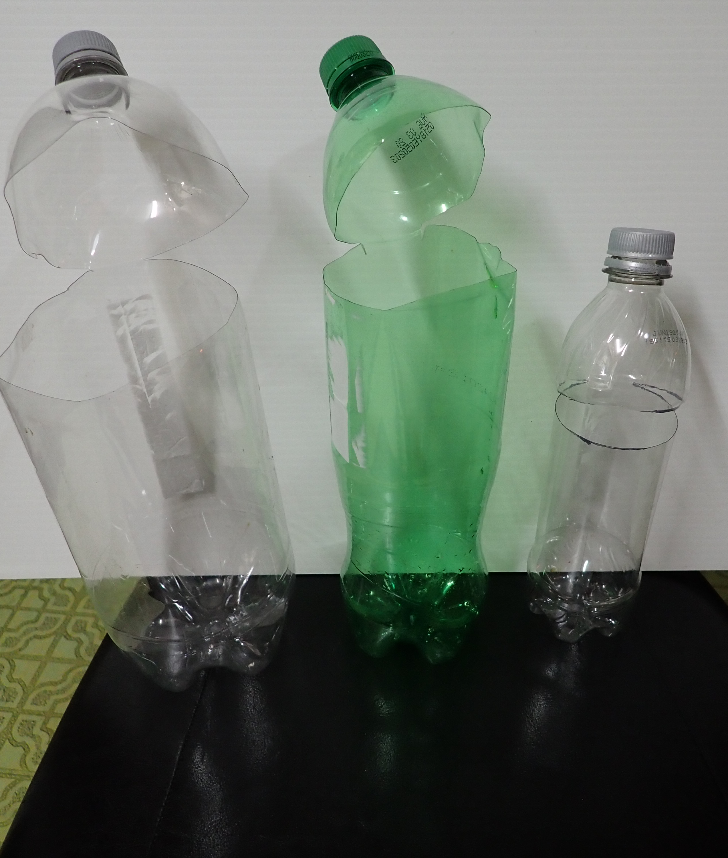
Prepare the Container
Make a Hinged top.
Notes:
Make a Hinged top.
Make a solid line (about 1 inch) between the two dots on the back of the bottle. Put an X over the line. Do Not cut! This will be the hinge.
Make a hole in the front. Using scissors, cut from the front to the back stopping at the dot on one side and then the other. Fold back on the solid line.
If the top is cut completely off, use duct tape to make a hinge or just leave it off. You will put it on after filling the bottle.

Slide 10
Compost Starter
Potting Soil
Notes:
Add ¼ cup of potting or gardening soil to the bottom of the container. This is the starter mix. It has living organisms that will help break down the material that is added to the container.
This is the reason outside compost bins should be in direct contact with the soil for it to work best. Microbes are necessary for the breakdown of the organic matter.

Slide 11
Two Types of Materials Nitrogen – Greens Carbon – Browns
Notes:
Examples of Nitrogen materials: Vegetable peelings from the kitchen, fresh grass clippings, etc.
Examples of Carbon materials: Tea leaves, coffee grounds, straw, leaves, etc. Shredded paper and newspaper. Cardboard.

Slide 12
Put a handful of nitrogen materials Add a handful of carbon materials
Notes:
Keep adding alternating layers of greens and browns until the material is an inch from the cut edge.
If the contents are dry, add ¼ cup of water.
Seal the cut edge of the container closed with duct tape. Make sure it is secure.
On the side opposite the hinge, put a piece of duct tape vertical with the bottle.
Then put a piece of duct tape from the hinge to the tape on the front. Repeat on the opposite side.
You may reinforce the tape making sure the top is secured to the bottom.
Double Check. Don’t make a mess!!!

Slide 13
Stir the Contents! Place the bottle on the table and gently roll the bottle. Slowly pick the end of the bottle up and rotate the bottle. When the bottle is upside down, continue to rotate the bottle, and turn it right side up. Continue until the contents are mixed well.

Slide 14
Mark the top of the contents of the bottle. Write the date.

Slide 15
Repeat the mixing directions each week. Mark the top of the contents and date. Note if the contents are dry. If no moisture appears on the side of the bottle, unscrew the lid and add a teaspoon of water. Mix the ingredients. Add more water if it still looks dry. Do Not add too much.

Slide 16
Too Much Water!
Open the lid and put in a sunny location so it can dry out.
Remember to put the lid back on when it has dried out.

Slide 17
Smells
Something went wrong!
Too much water?
Open the duct tape.
Add shredded newspaper.
Notes:
After adding newspaper, retape the container closed. Mix as usual.
Newspaper absorbs odors! Also put the container outside for a week!
If it is too far gone, toss it and start over. Too much water is just too much water!

Slide 18
When finished –
Let the compost rest for about 3 to 6 weeks.
It should smell like fresh soil.

Slide 19
Cut the duct tape and dump the contents into a small flowerpot.
Add more potting soil if needed.
Plant a plant in the container and watch it grow!

Slide 20
Congratulate the students,
they have taken
old material and renewed it
into usable soil!

Slide 21
Thank you
Diane Curlee
dcurlee@orangeburgcounty.org
www.Orangeburgswcd.com

