Slide 1
NC Share Fair
Lisa Marochak- Durham Soil & Water
Lisa Pope- Orange Soil & Water

Slide 2
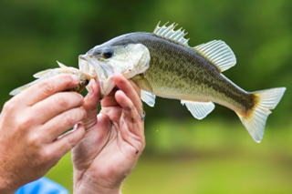
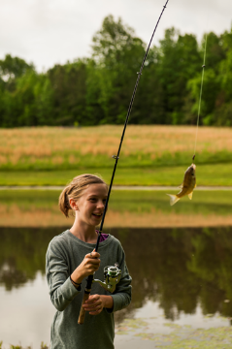
ANNUAL POND CLINIC

Slide 3
PLANNING
Meet with committee
Select site location and topics
Select presenters
Reserve shock boat
Send out fundraising letters
Select Caterer
Create and send out flyer
Prepare agenda
Order sponsor banner
Fishing Tournament Prizes and Door Prizes

Slide 4
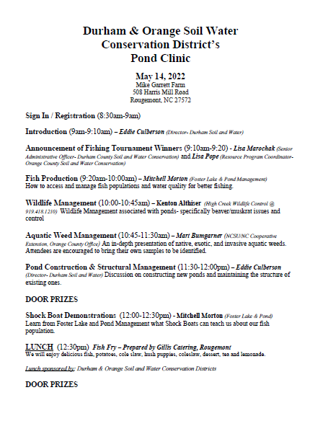
AGENDA
Fishing Tournament
Aquatic Weed Management
Wildlife Management
Pond Construction & Structural Management
Shock Boat Demonstration

Slide 5
FLYER

Slide 6
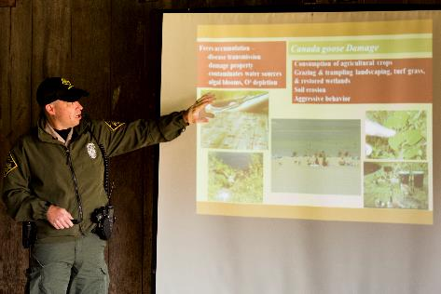
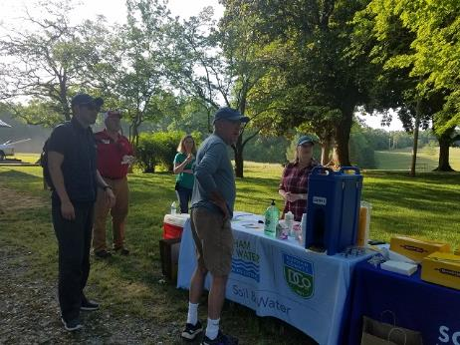

Slide 7
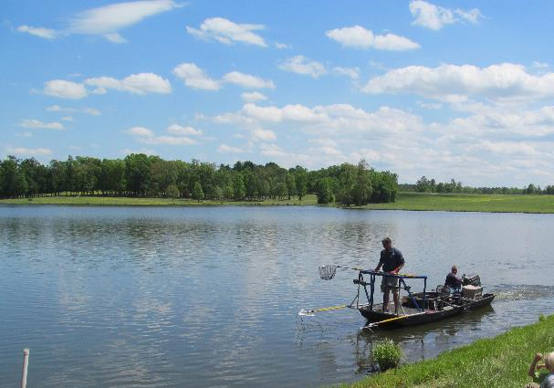
SHOCK BOAT DEMONSTRATION

Slide 8
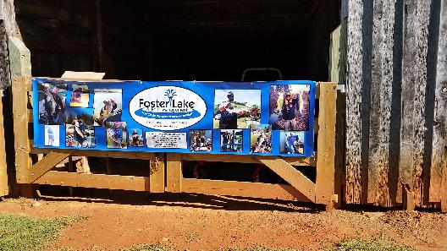
SPONSORS/FUNDRAISING $

Slide 9
Thank you
Lisa Marochak- Durham Soil & Water
Lmarochak@dconc.gov
919-560-0558
Lisa Pope- Orange Soil & Water
Lpope@orangecountync.gov
919-245-2750

