Slide 1
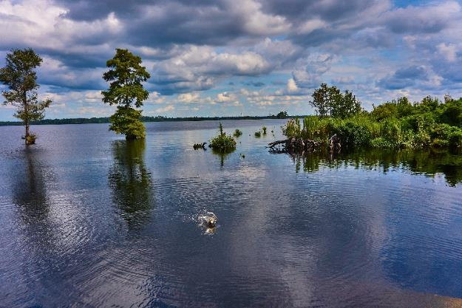
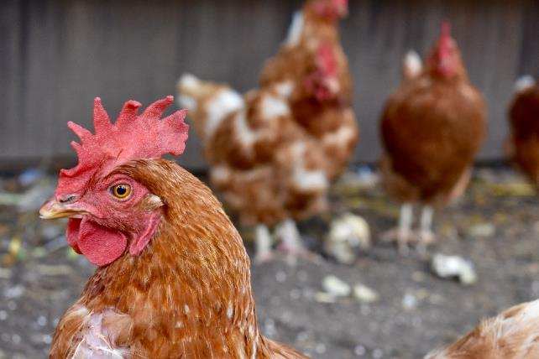
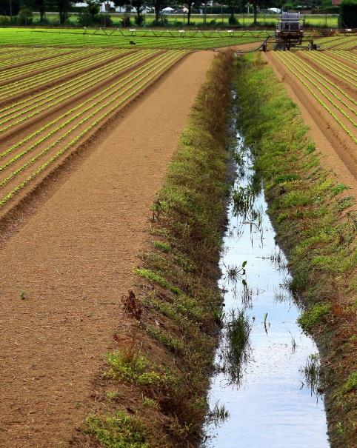
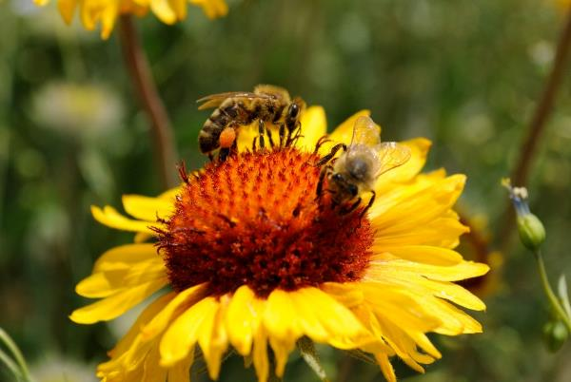
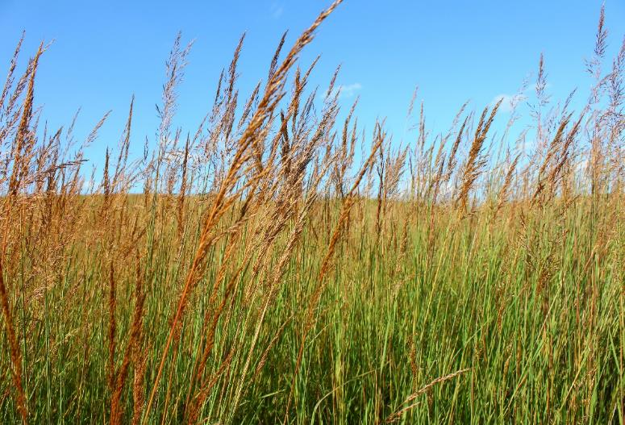
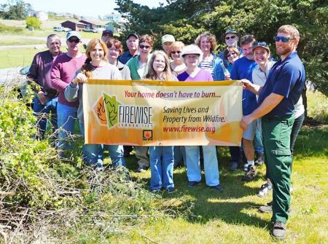
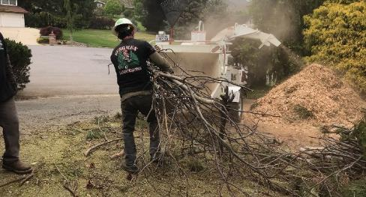

Slide 2
What Does NACD Do?
Provide one voice for conservation
Advocate for programs, policy and funding for conservation on Capitol Hill and throughout the country
Communicate through publications, blogs and social media
Develop conservation leaders
Provide direct services to conservation districts
Grants

Slide 3
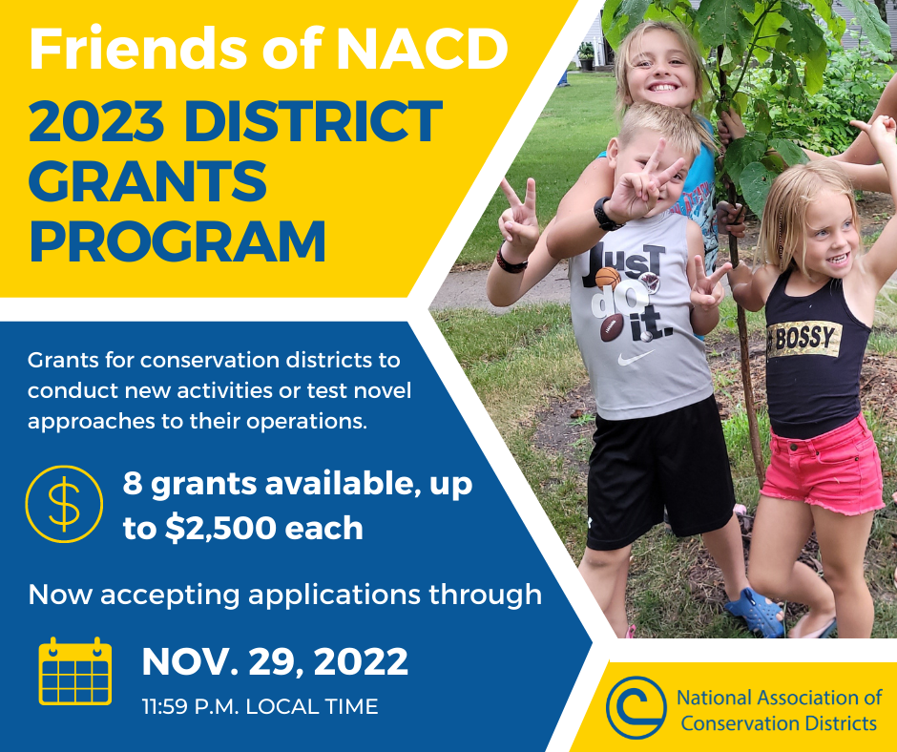
Friends of NACD District Grants
Now accepting proposals!
8 grants, up to $2,500 each are available for conservation districts to conduct new activities or test novel approaches
Deadline to apply: Nov. 29, 2022
www.nacdnet.org/get-involved/friends-of-nacd/friends-of-nacd-district-grants-program

Slide 4
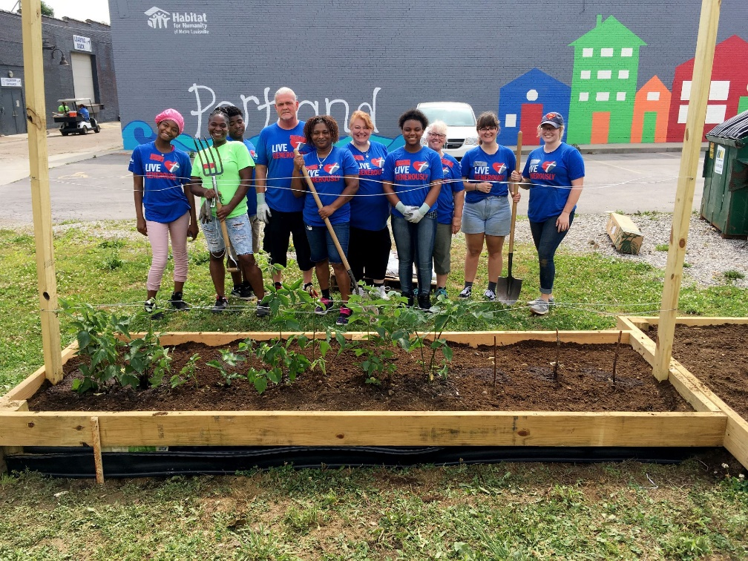
Urban Ag Conservation Grants
To address natural resource issues in both developed and developing areas of communities
In the Southeast, 19 districts have implemented 20 projects
In Kentucky, Jefferson County SWCD was a 2016 and 2021 UAC grantee
www.nacdnet.org/about-nacd/what-we-do/urban-and-community

Slide 5
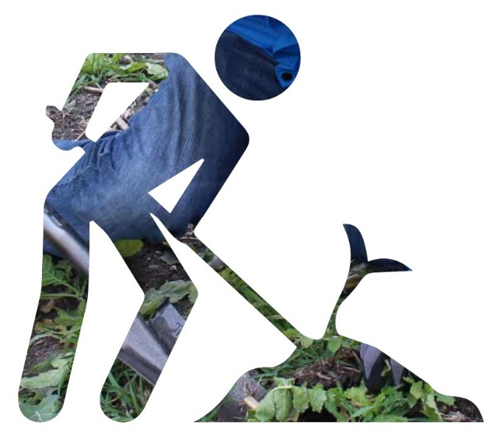
Technical Assistance Grants
Funding for “boots on the ground” to support conservation planning and technical assistance, EQIP and CSP
State conservation partners identify high priorities and invite districts to apply
www.nacdnet.org/technical-assistance-grants

Slide 6
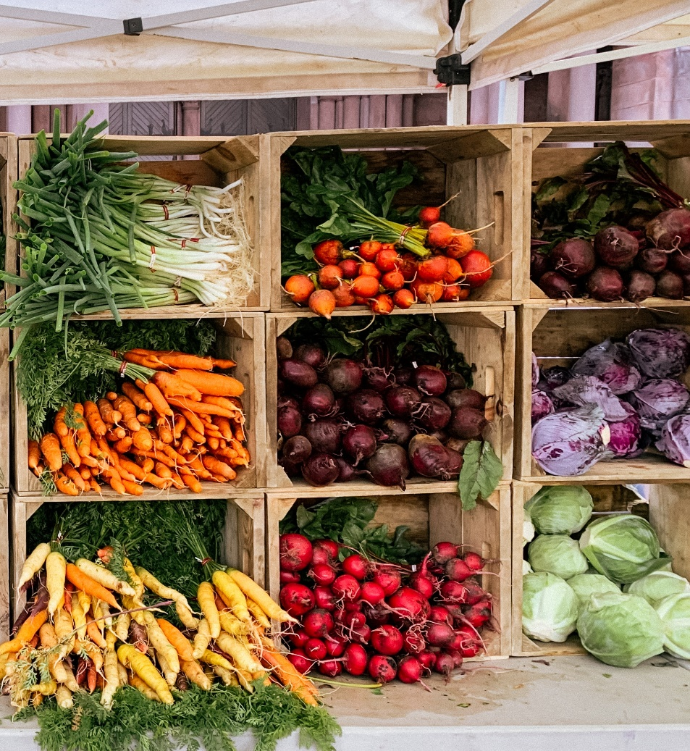
Climate Smart Commodities Grant
NACD selected as a partner in USDA’s $2.8 billion Climate Smart Commodities program
Program supports the production and marketing of climate-smart commodities through a set of pilot projects that provide voluntary incentives

Slide 7
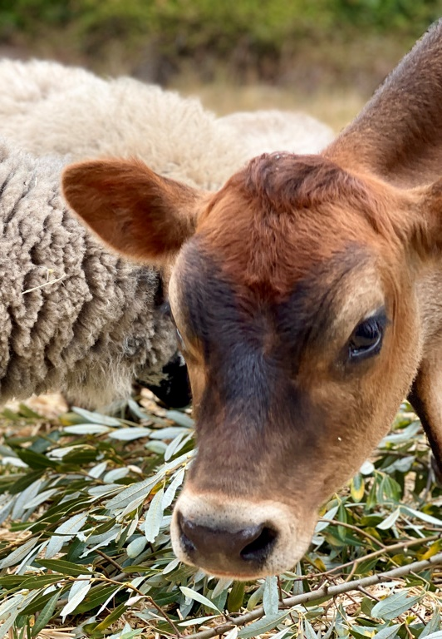
Climate Smart Commodities Grant
NACD Project Objectives
Generate interest and momentum within individual communities across the nation.
Spur individual action via technical assistance, conservation planning, and financial assistance incentives.
Provide sound data to inform producers’ decision-making processes.
Cultivate trust building in and growth of conservation systems, implementation, and markets.

Slide 8
NACD Programming
Climate Smart Commodities Grant
Advance Pilots to Scale Climate-Smart Practices | Carbon and GHG Quantification & MRV | Market Facilitation & Access
NACD Pass-Through Grant Program Emphasis on innovative pilots and projects Funding for technical and financial assistance Includes local, state, or regional market facilitation and access Requires quantification and MRV plans Significant equity and access components Enhanced Technical Assistance Model | Data democratization initiative with HabiTerre (Farm Carbon reports) HabiTerre Quantification Modeling and comparison to COMET (producers may also utilize another model or ecosystem service) Remote sensing to support monitoring and verification of practices | National programming and educational opportunities to keep associations and districts informed of evolving trends, standards, and market opportunities Stakeholder roundtables with the goal of advancing equity, access, and inclusions National information sharing hub for grant and project opportunities Expanded outreach to market players

Slide 9
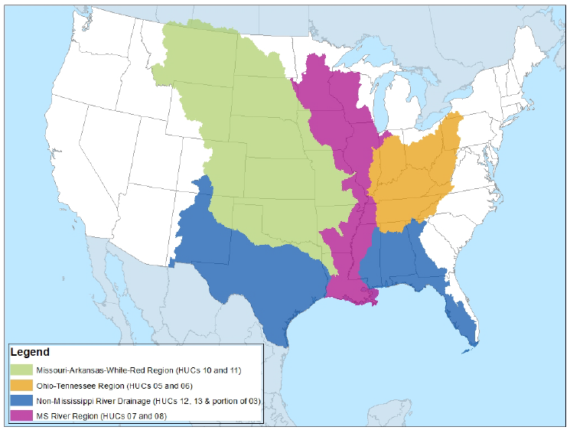
Historically Underserved Farmer to Farmer Outreach Grants
NACD has been awarded a $3 million grant from the EPA’s Gulf of Mexico Division’s Historically Underserved Farmer to Farmer Grants Program

Slide 10
Historically Underserved Farmer to Farmer Outreach Grants
Program Objectives:
Novel or innovative techniques, methods, or approaches to improve adoption of resilient and sustainable practices;
Increase collaboration, including within and among farming communities;
Data collection and analysis to demonstrate the results of the applied technique(s), method(s) or approach(es); and
Effective communication of project results to the farming community to inform future farm management and to better understand the most cost-effective and sustainable farming approaches

Slide 11
Candice Abinanti
NACD Southeast Region Representative
p: 803-579-7230
candice-abinanti@nacdnet.org

