Slide 1
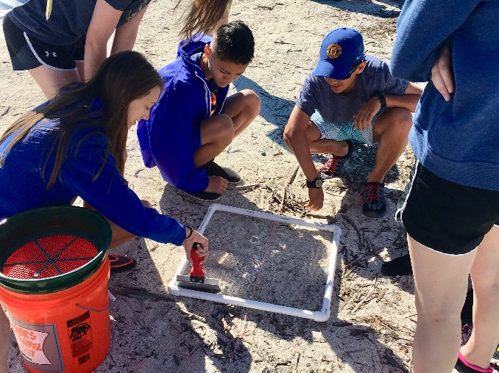
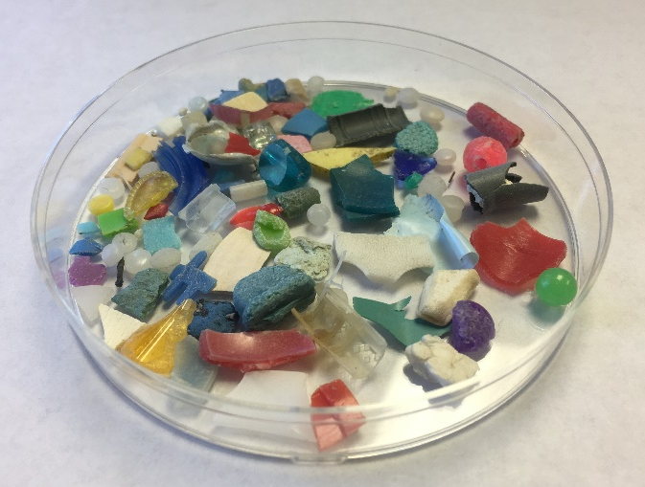
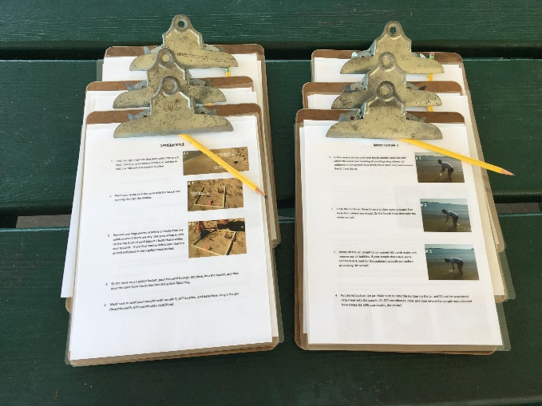


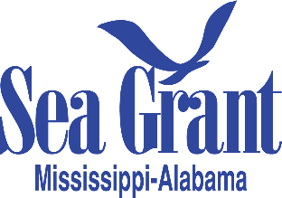

ENGAGING CITIZEN SCIENTISTS to
ASSESS LARGE-SCALE MICROPLASTIC DISTRIBUTIONS
Mandy Sartain Extension Program Assistant & Marine Debris Specialist
Caitlin Wessel NOAA Marine Debris
Eric Sparks Assistant Extension Professor & Coastal Ecology Specialist

Slide 2

Microplastics

Slide 3
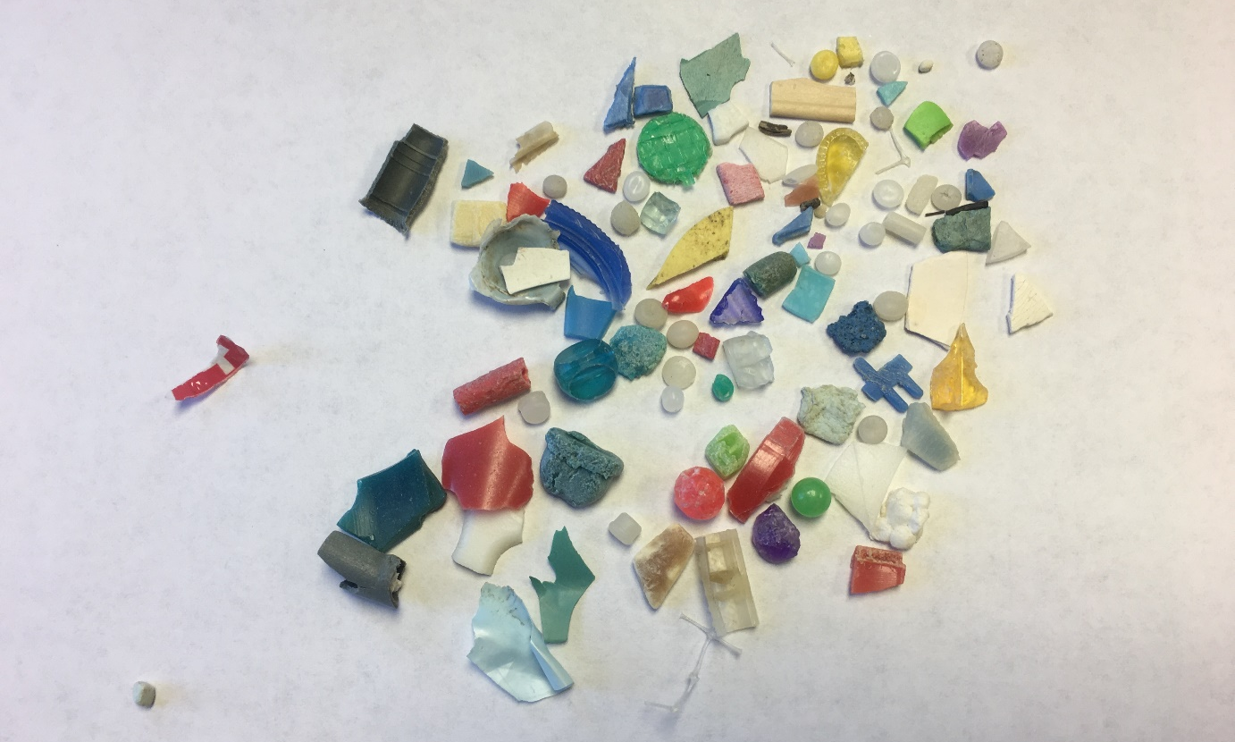
Microplastics:
Plastic pieces 5 millimeters in size or smaller.

Slide 4
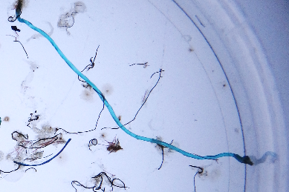
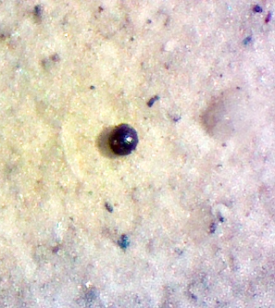
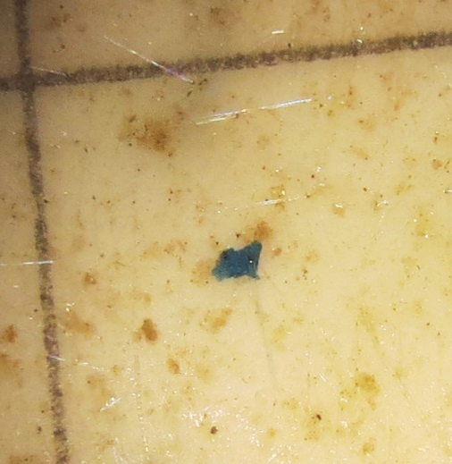
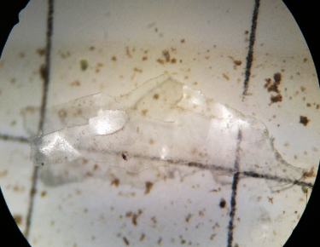
Microplastics:
Plastic pieces 5 millimeters in size or smaller.
  Categorized as microbeads, fragments, films and fibers.
Bead
Fragment
Film
Fiber
Photos by: Florida Microplastic Awareness Project & Caitlin Wessel

Slide 5

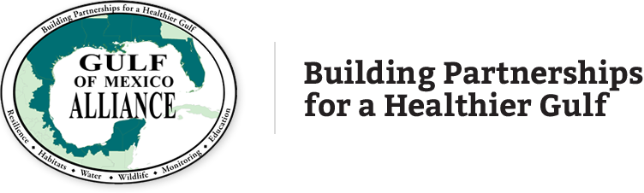
Project Overview:
  Two year program funded by the Gulf of Mexico Alliance Gulf Star Grant.
  January 2017 – December 2018

Slide 6
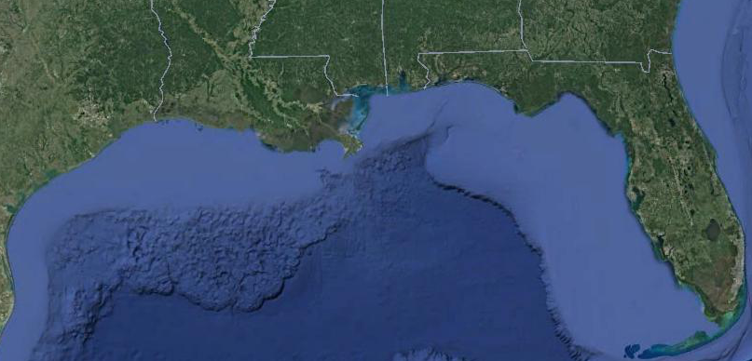
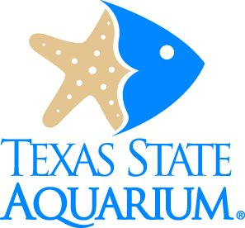
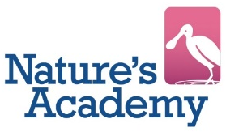
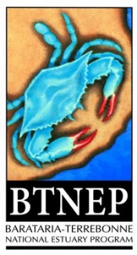
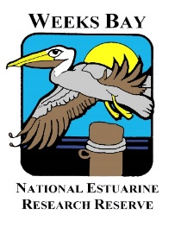


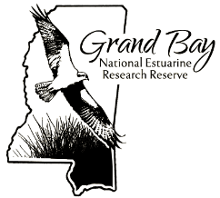
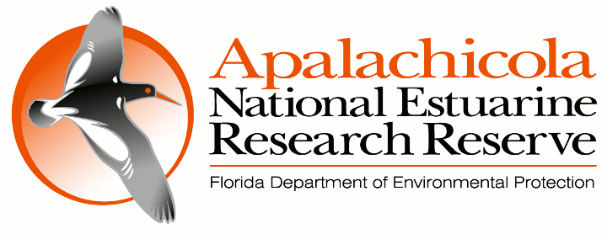
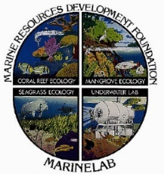
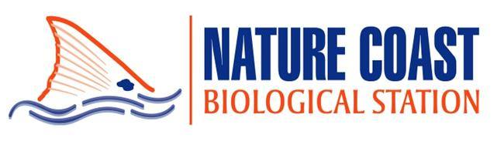

Project Overview:
  Multiple partners involved all along the Gulf of Mexico Coast train their local citizen scientists.

Slide 7

Project partners work with citizen scientist to collect and analyze samples.
Nature’s Academy

Slide 8
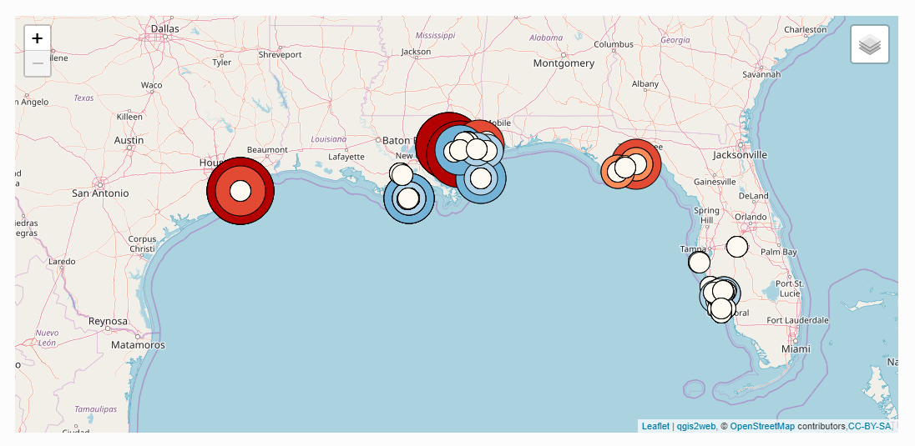
Project Overview:
  Data collected and analyzed by citizen scientist goes into a Gulf-wide data pool.
coastal.msstate.edu/microplastics

Slide 9
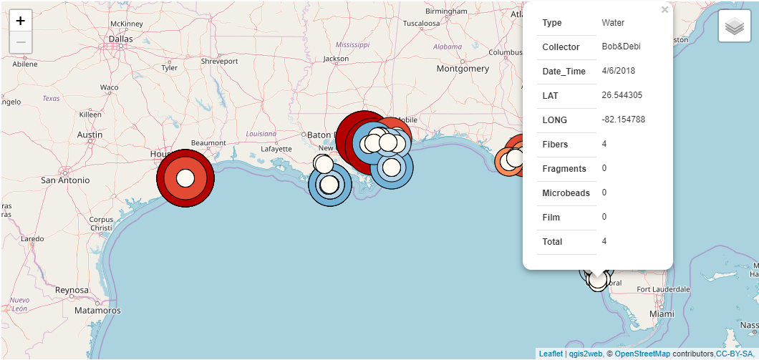
Project Overview:
  Data collected and analyzed by citizen scientist goes into a Gulf-wide data pool.
coastal.msstate.edu/microplastics

Slide 10
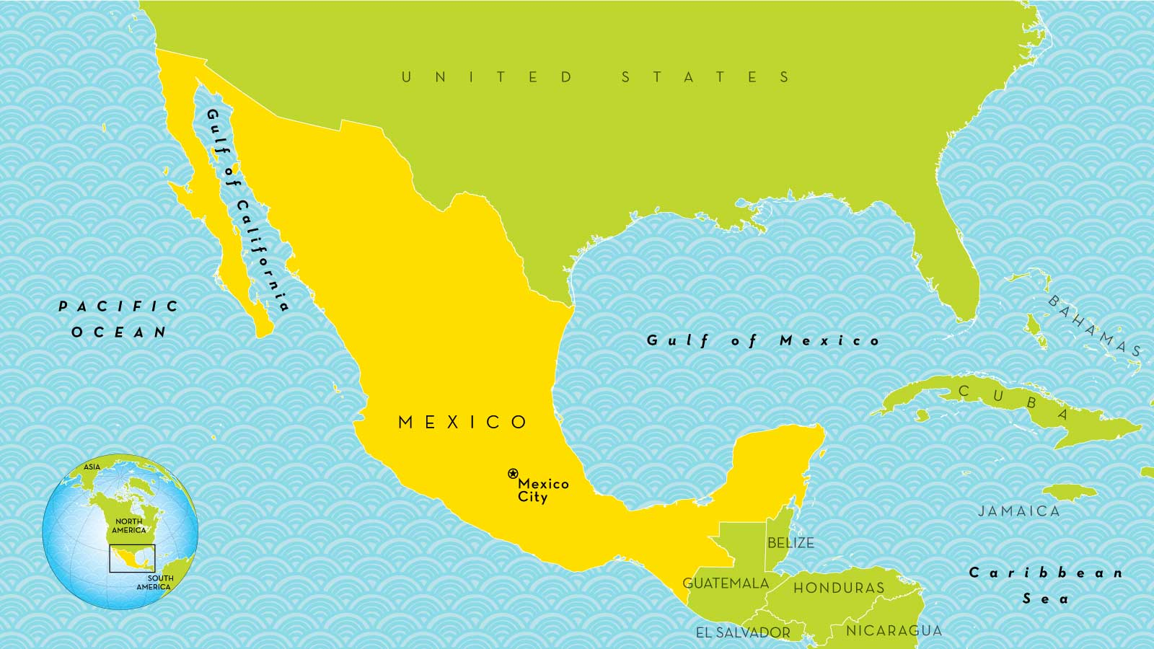
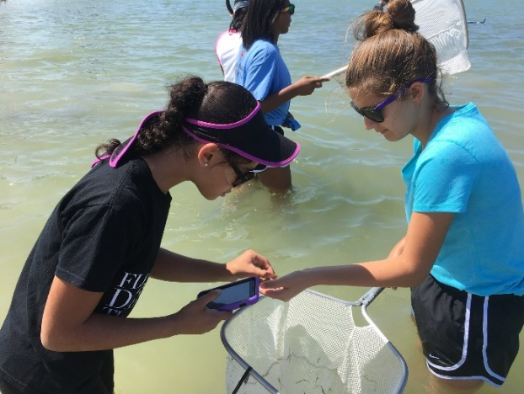
Project Goals:
Increase awareness of the microplastic marine debris issues by connecting with and involving the public.
Develop educational materials to be distributed by project partners and trained citizen scientists to advance community environmental literacy.
Acquire estimated microplastic abundance in the Northern Gulf of Mexico.
?
Nature’s Academy

Slide 11
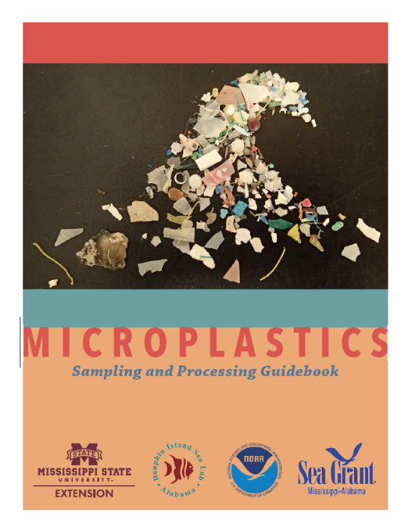
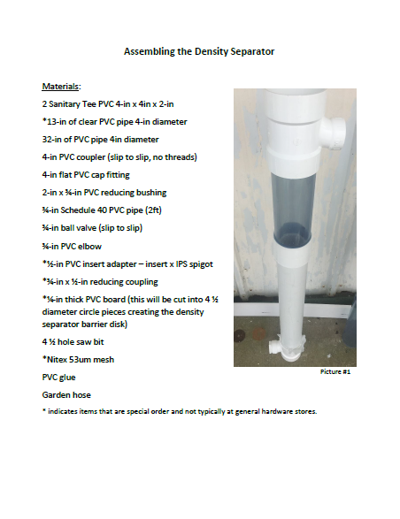
Microplastic Sampling and Processing Guidebook
Assembling the Density Separator Guidebook

Slide 12
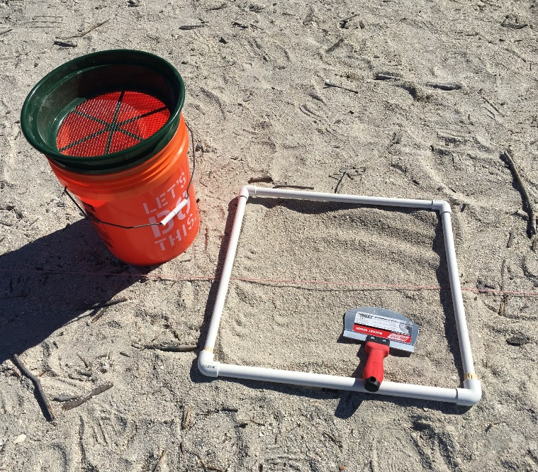

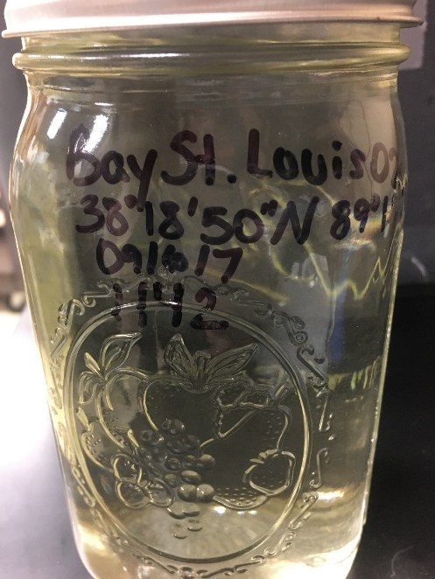
SEDIMENT & WATER

Slide 13
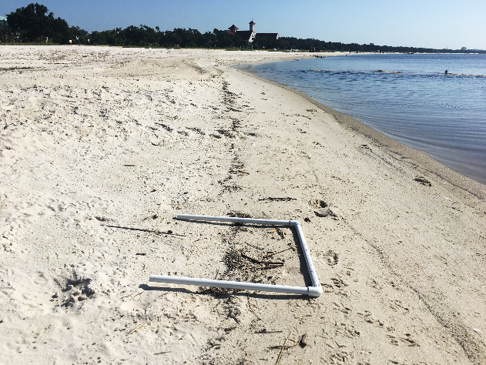
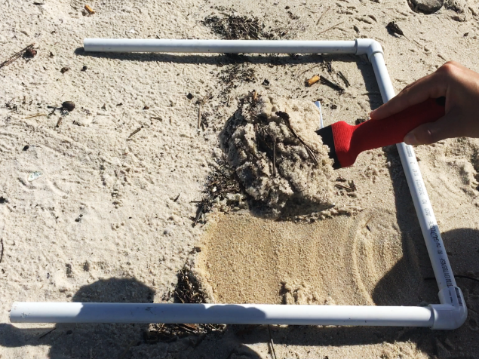
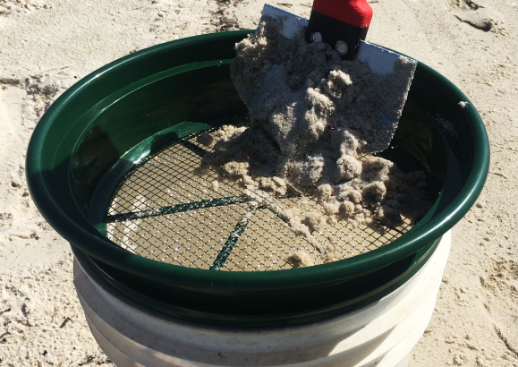
Collecting Sediment Samples
Collected at high, high tide line (wrack line).
Top 3 centimeters of sand within a 0.25m² quadrat is collected.
Pour through 5mm sieve into 5 gallon bucket
Dump sand into a gallon Ziploc bag. Labeled with sample #, GPS coordinates, date, and time where the sample was collected from.

Slide 14
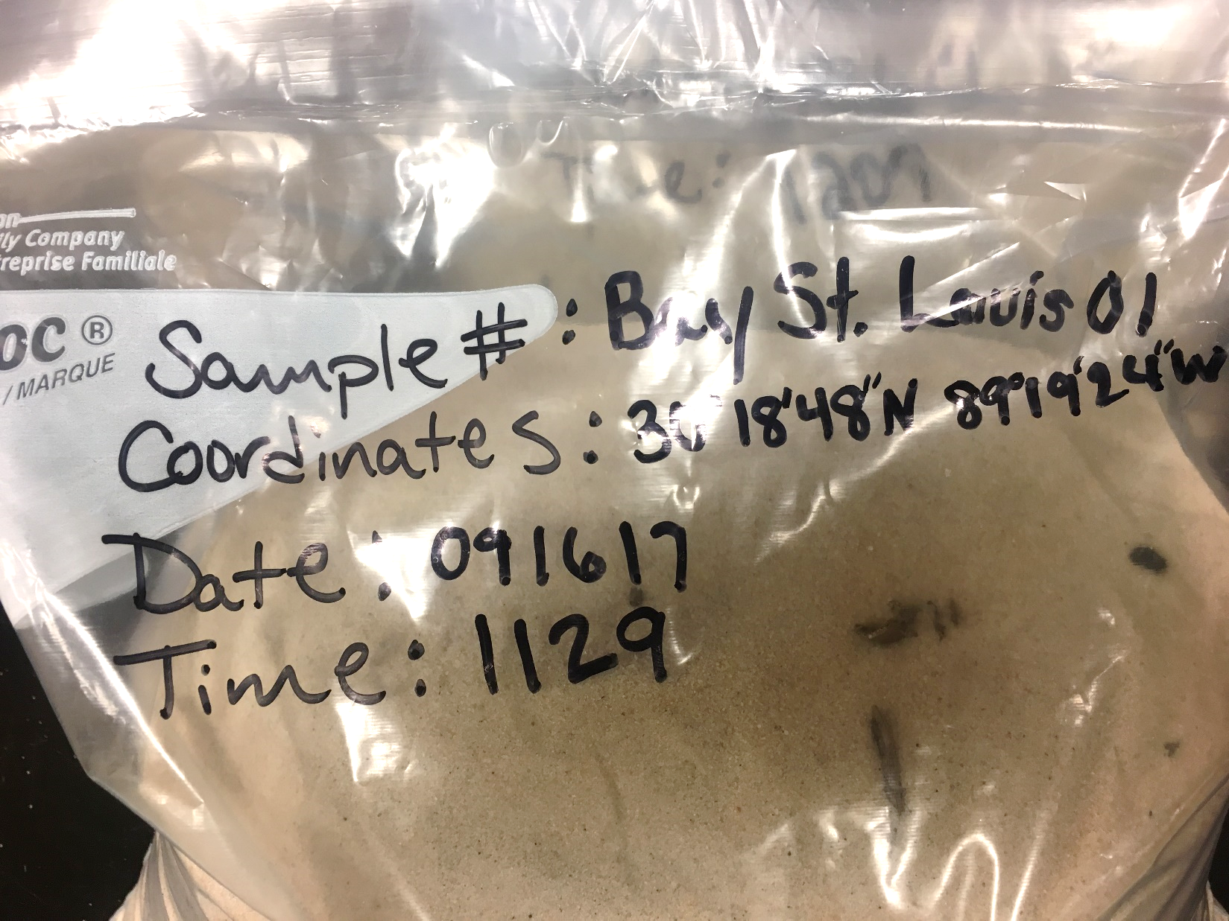
Collecting Sediment Samples
Collected at high, high tide line (wrack line).
Top 3 centimeters of sand within a 0.25m² quadrat is collected.
Pour through 5mm sieve into 5 gallon bucket
Dump sand into a gallon Ziploc bag. Labeled with sample #, GPS coordinates, date, and time where the sample was collected from.

Slide 15
Collecting Water Samples
1 liter water samples
Surface water
Fill jar completely
Label jar with sample #, GPS coordinates, date, and time where the sample was collected from.
Photos by Caitlin Wessel

Slide 16

Collecting Water Samples
1 liter water samples
Surface water
Fill jar completely
Label jar with sample #, GPS coordinates, date, and time where the sample was collected from.

Slide 17
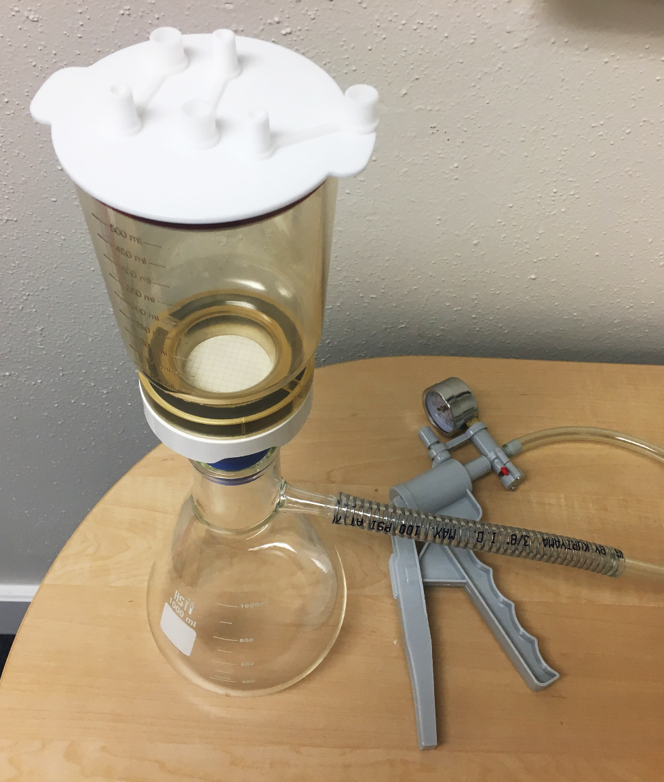
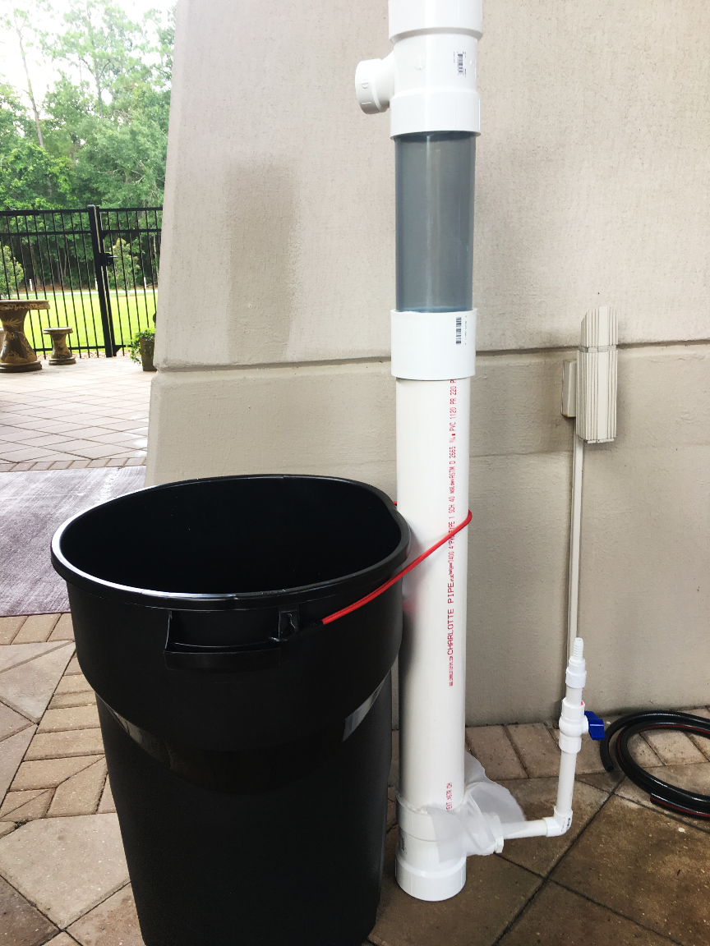
Sample Processing
Sediment
Water

Slide 18
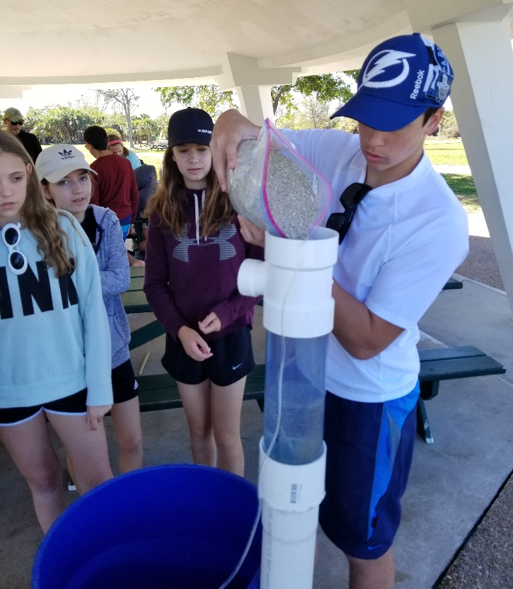
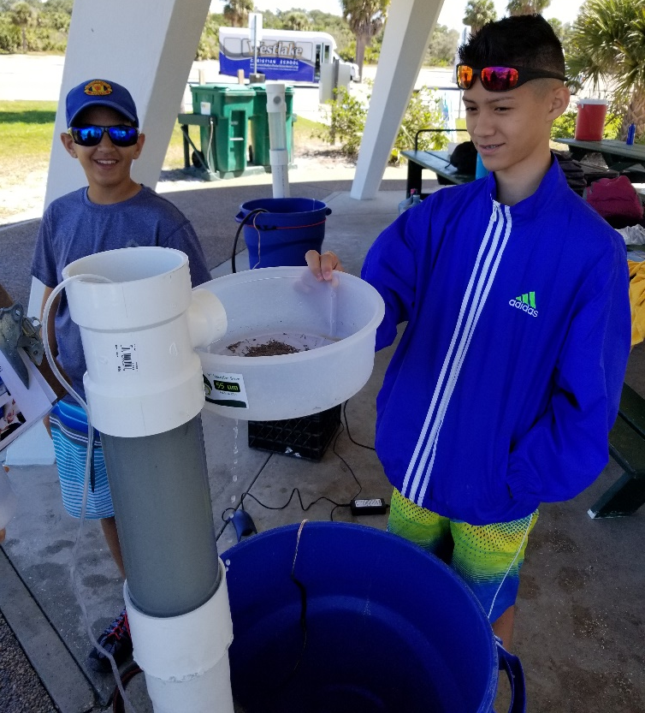
Processing Sediment Samples
Run sand samples through density separator.
  Microplastics will float up and out of the sediment.
Collect microplastics in sieve
Nature’s Academy
Nature’s Academy

Slide 19
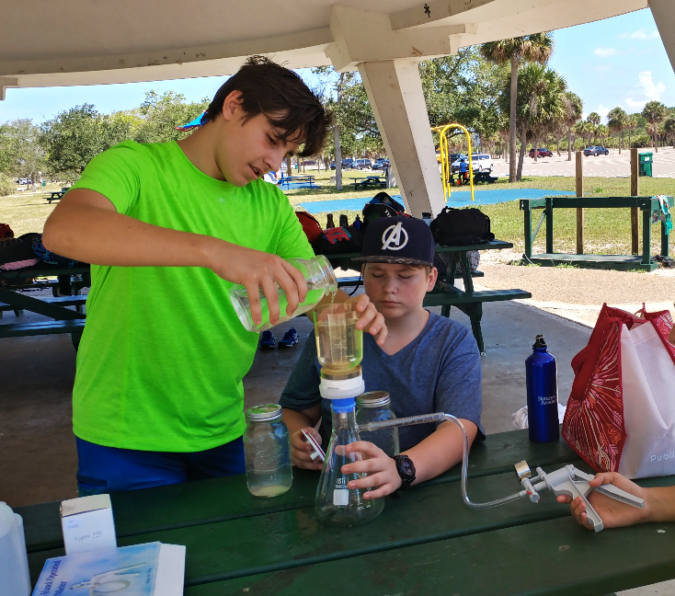
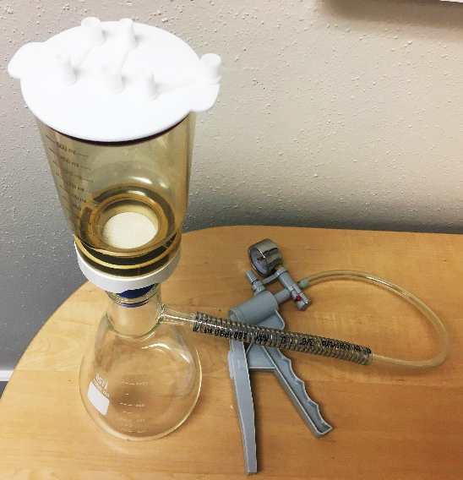
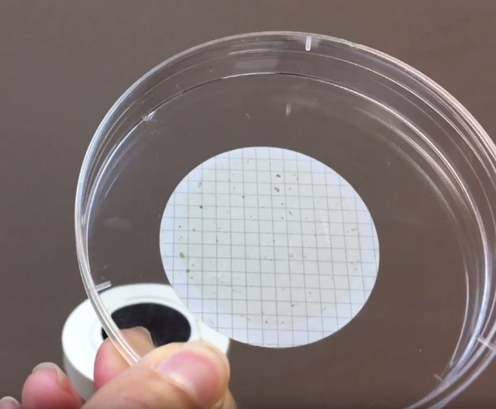
Processing Water Samples
Place gridded filter on funnel holder.
Vacuum pump water sample through filter funnel.
Filter will collect microplastics (pore size 0.45μm)
Once all the water is filtered through, remove filter and place in petri dish.
Nature’s Academy

Slide 20
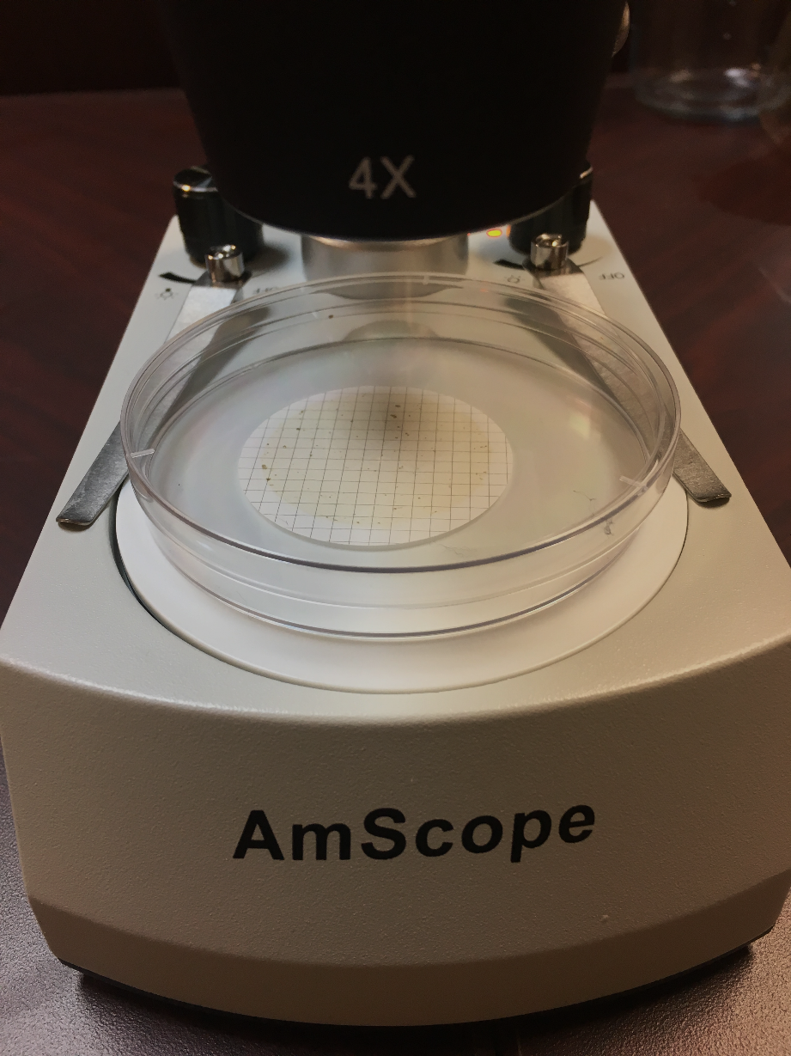
Sample Analysis

Slide 21
Sample Analysis
Bead
Film
Fiber
Fragment
Photos by: Florida Microplastic Awareness Project & Caitlin Wessel

Slide 22
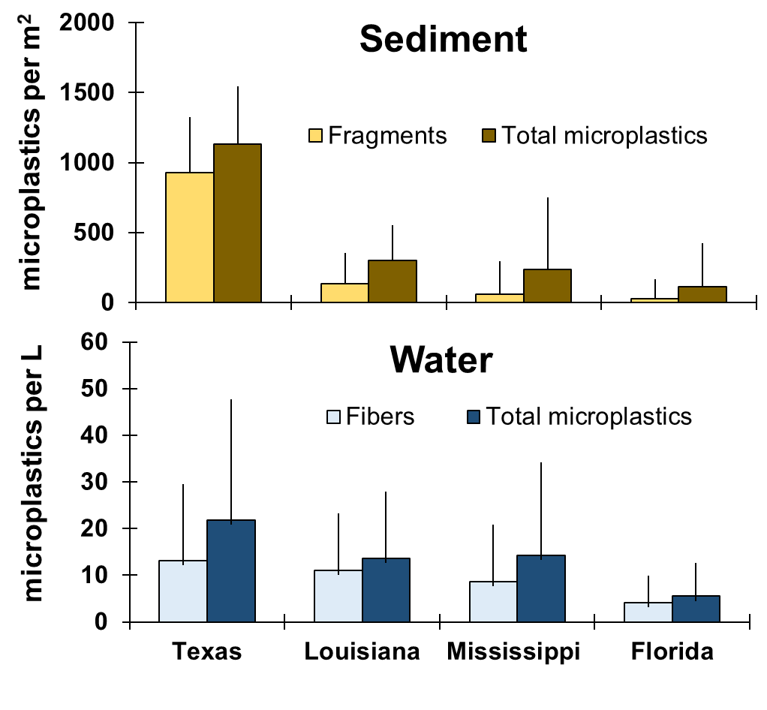
What we are finding:

Slide 23
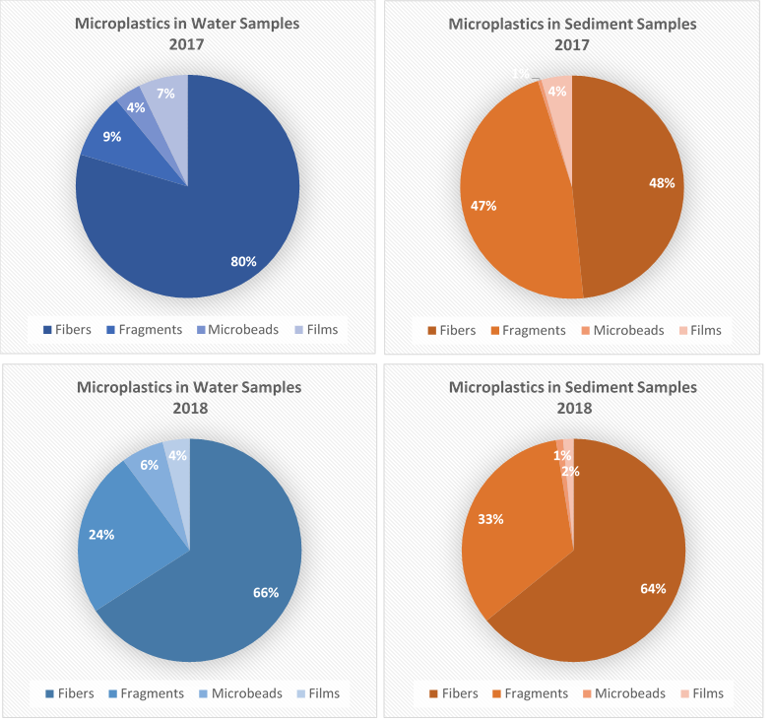
What we are finding:

Slide 24
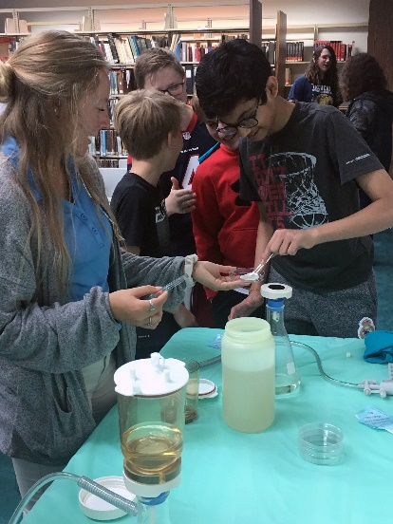
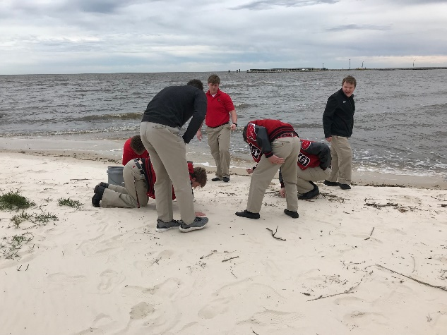




Thus far:
Over two dozen organizations trained
Countless citizen scientists involved
583 data submissions

Slide 25
Future Outlook:
Continue microplastic monitoring!
Supplies ✓
Knowledge ✓
Community interest ✓
Data and framework will be used in grad project. The focus of the thesis will be furthering exploration of this dataset as well as validation of citizen science data across multiple groups (e.g., children, trained adults, untrained adults, etc.).

Slide 26
Acknowledgements
Gulf of Mexico Alliance ● Dauphin Island Sea Lab ● University of Florida, Nature Coast Biological Station ● Nature’s Academy ● Charlotte’s Harbor NEP (CHNEP) ● Key Largo Marine Lab - Marine Resources Development Foundation ● Florida Agricultural and Mechanical University (FAMU) ● Apalachicola NERR (ANERR) ● Turtle Island Restoration Network (TIRN) ● Texas Parks and Wildlife Department ● Barataria-Terrebonne National Estuary Program (BTNEP) ● Texas State Aquarium ● Weeks Bay NERR ● Grand Bay NERR

