Slide 2
What is a BMP Expo? How is it beneficial? Is it worth your time?

Slide 3
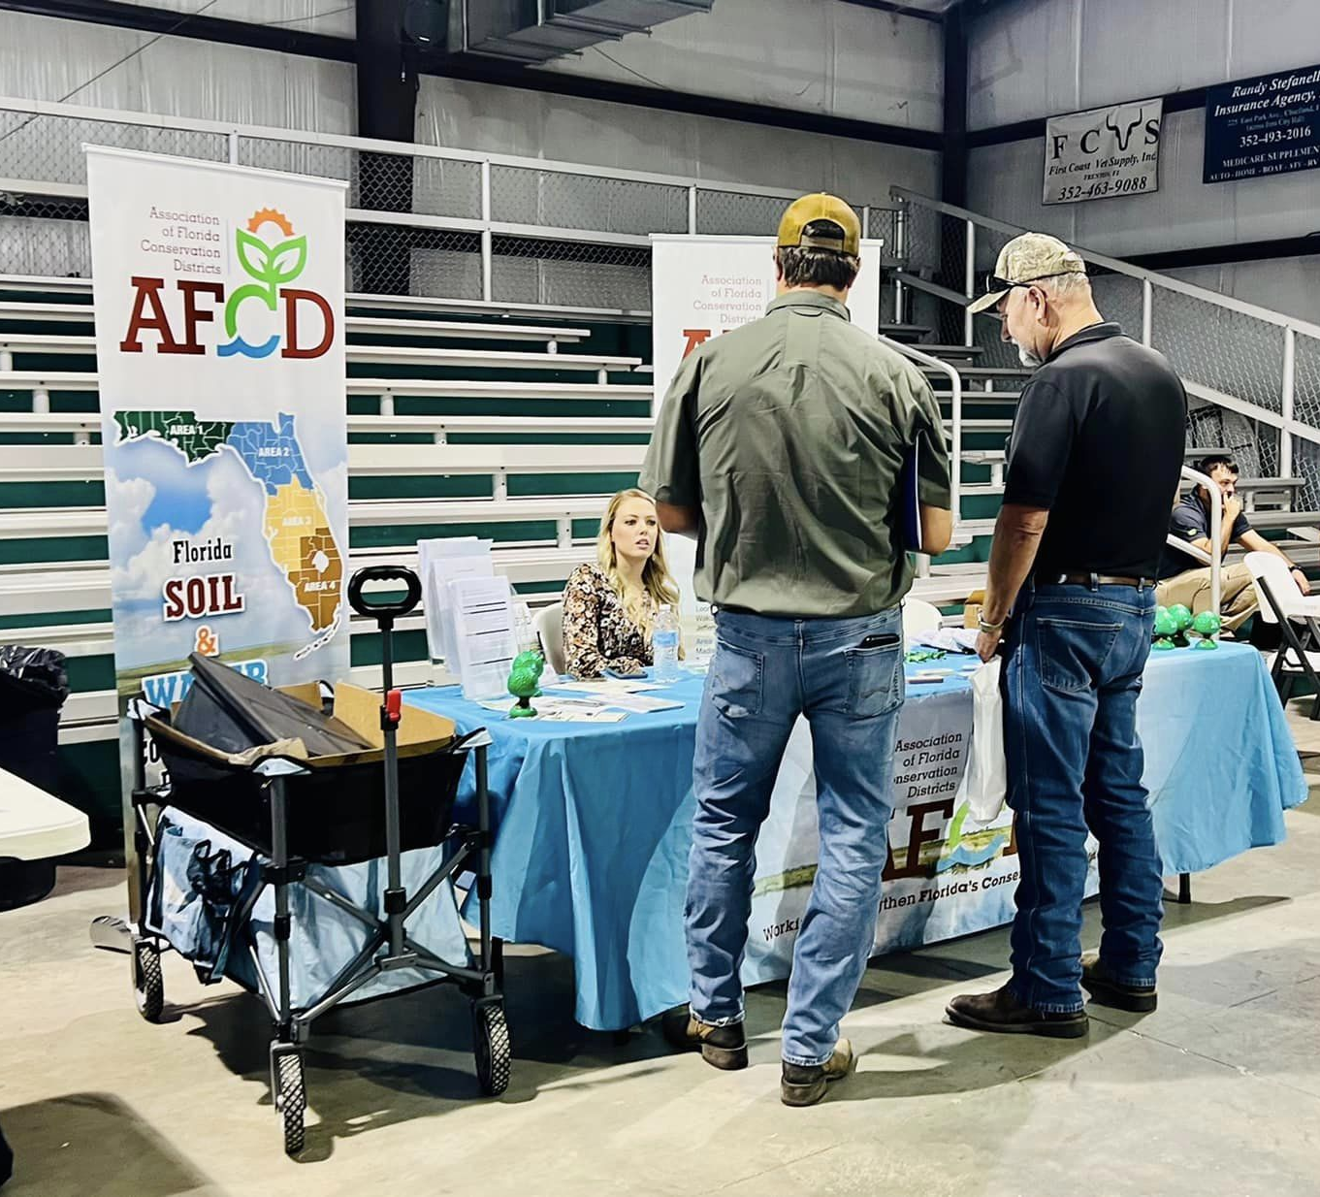
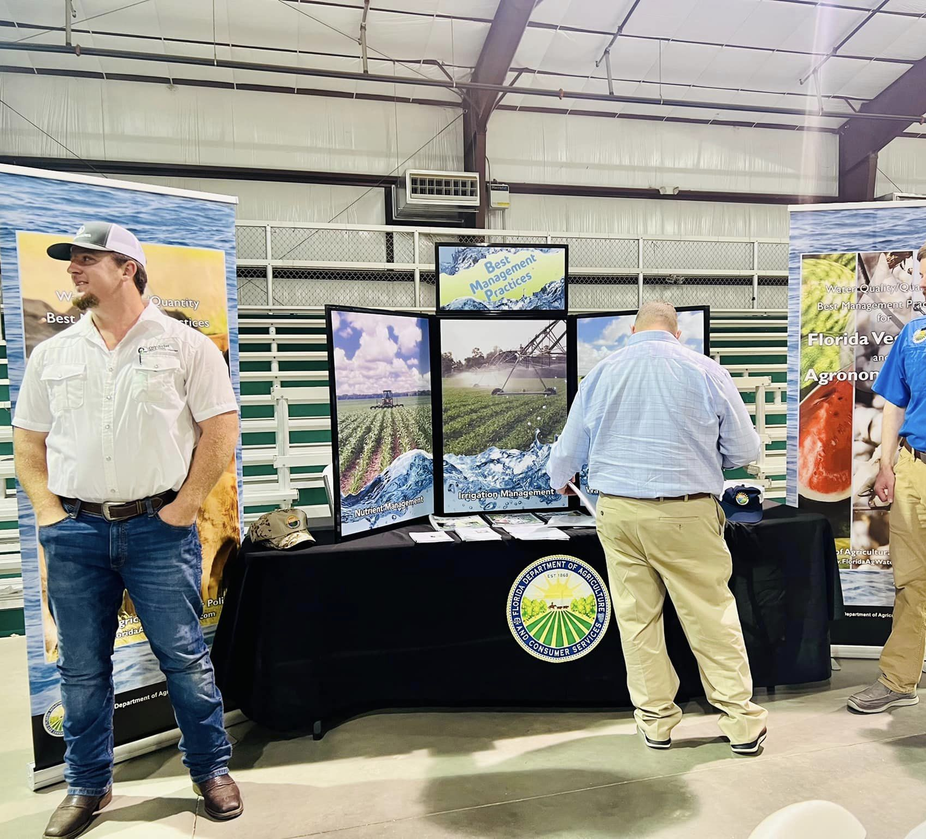
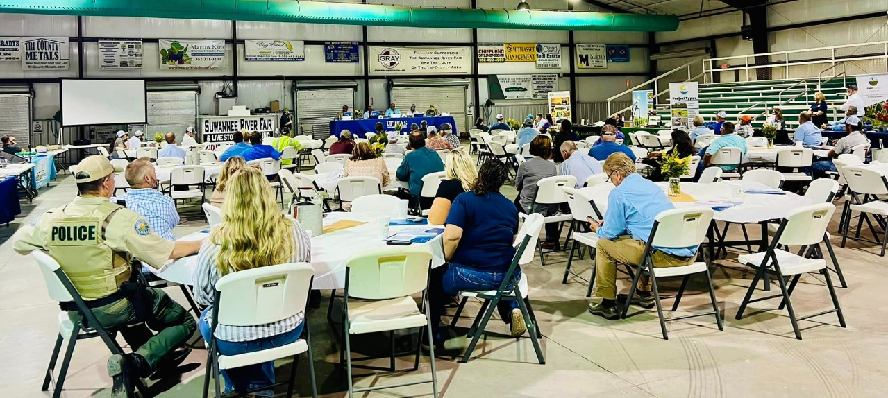
Who do you want there?
Producers
Government Agencies
Local Vendors

Slide 4
How to guide the agency & vendor expo:

Slide 7
What does the night look like and what do you talk about?

Slide 8
The look when I first sat in a meeting using all the acronyms
SRWMD
SJRWMD
SWFWMD
BMAP
TMDL
BMPs
NOI
IV
IA
MFLs
ERP
OSTDS
DEP

Slide 9
Find out what producers want to know…

Slide 10
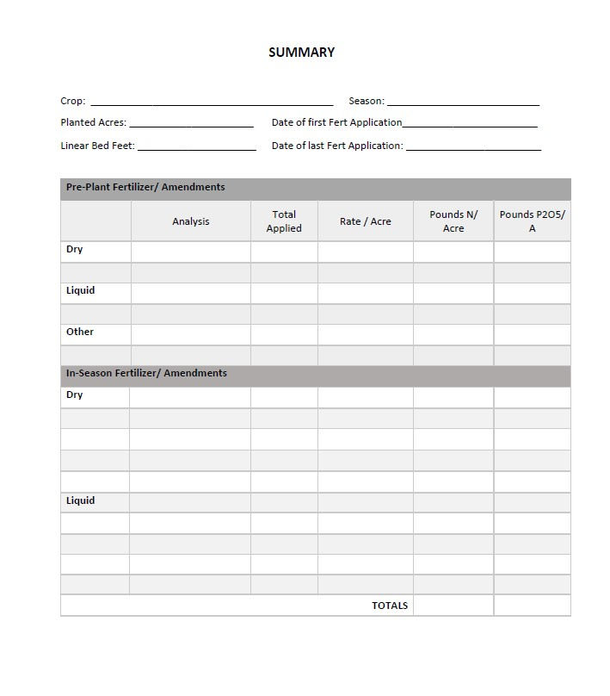
Consolidate it so it’s easier to use

Slide 11
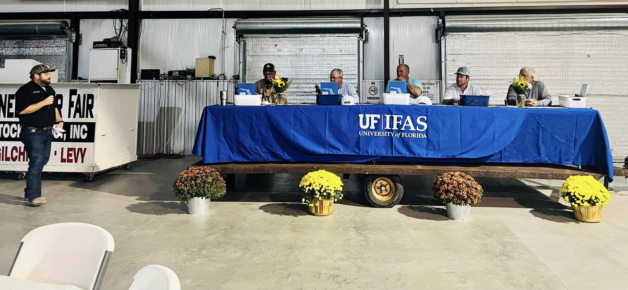
Producer Panel

Slide 12
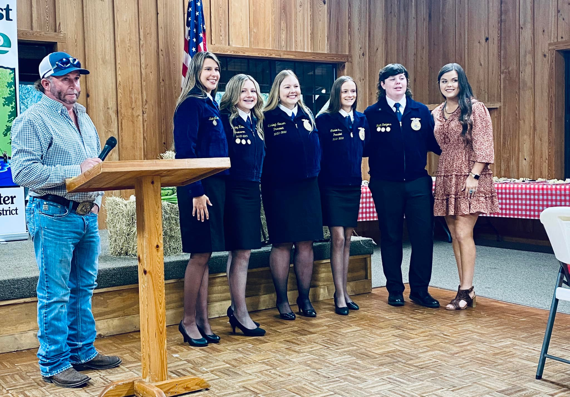
Incorporate your area youth

Slide 13
Feel Free to contact me:

