Slide 1
Traveling Book Barn
November 2022
SECDEA Conference
Audrey Kuipers

Slide 2
DESIGN
THINGS TO CONSIDER
How will it be transported?
Who will be transporting it?
Who is building it?
How will it be loaned out?

Slide 3
Design
THINGS TO CONSIDER
Design it to fit most vehicles
Make it as light as possible
Make it mobile
Include book storage

Slide 4
Community Involvement

Slide 5
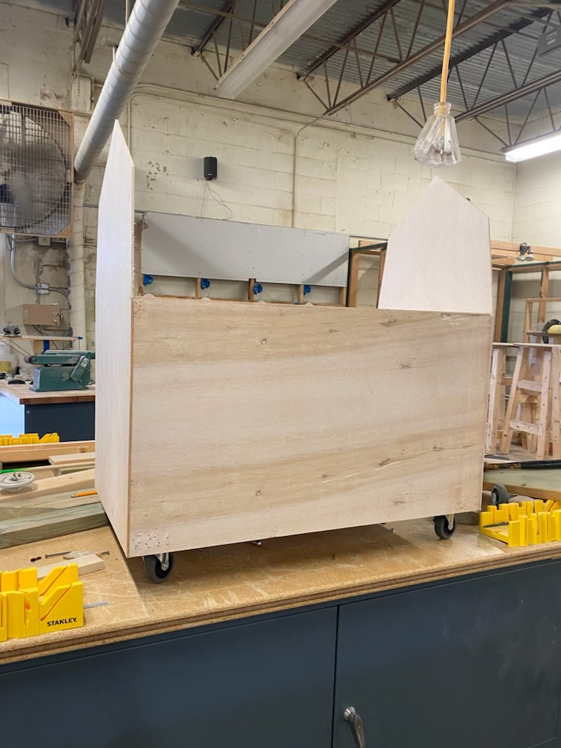
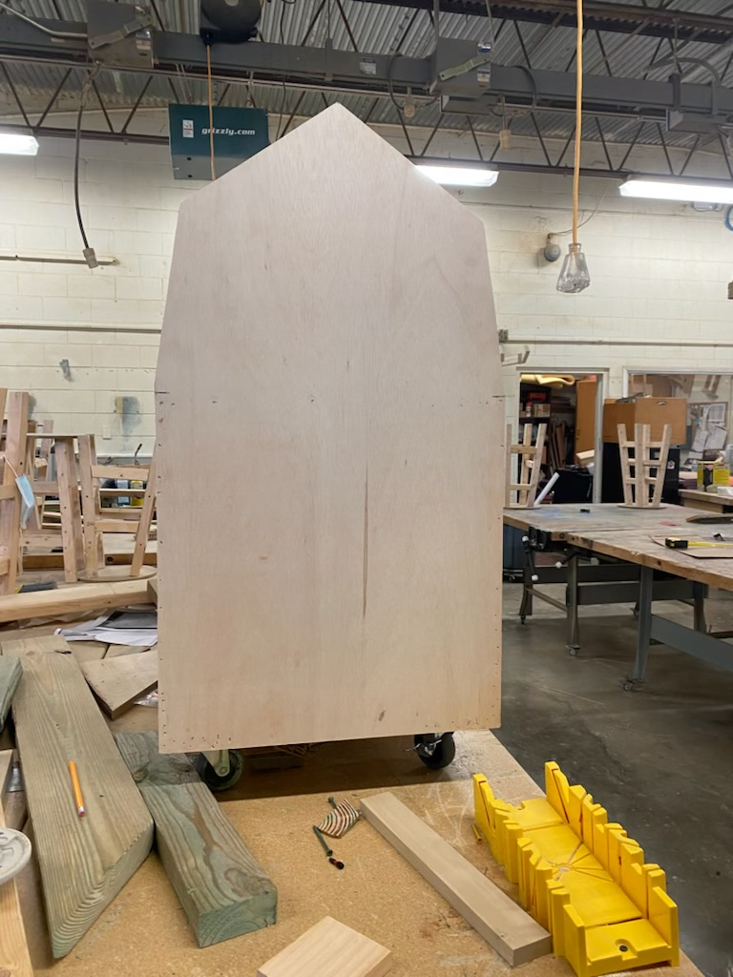
Construction
Commences

Slide 6
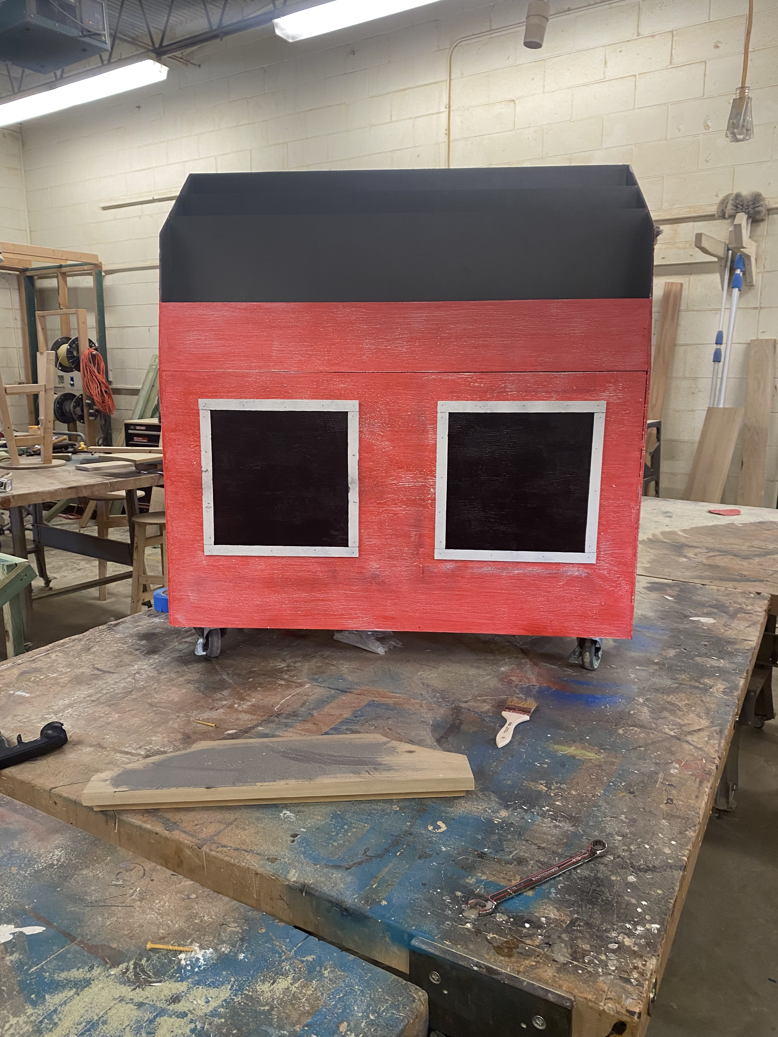
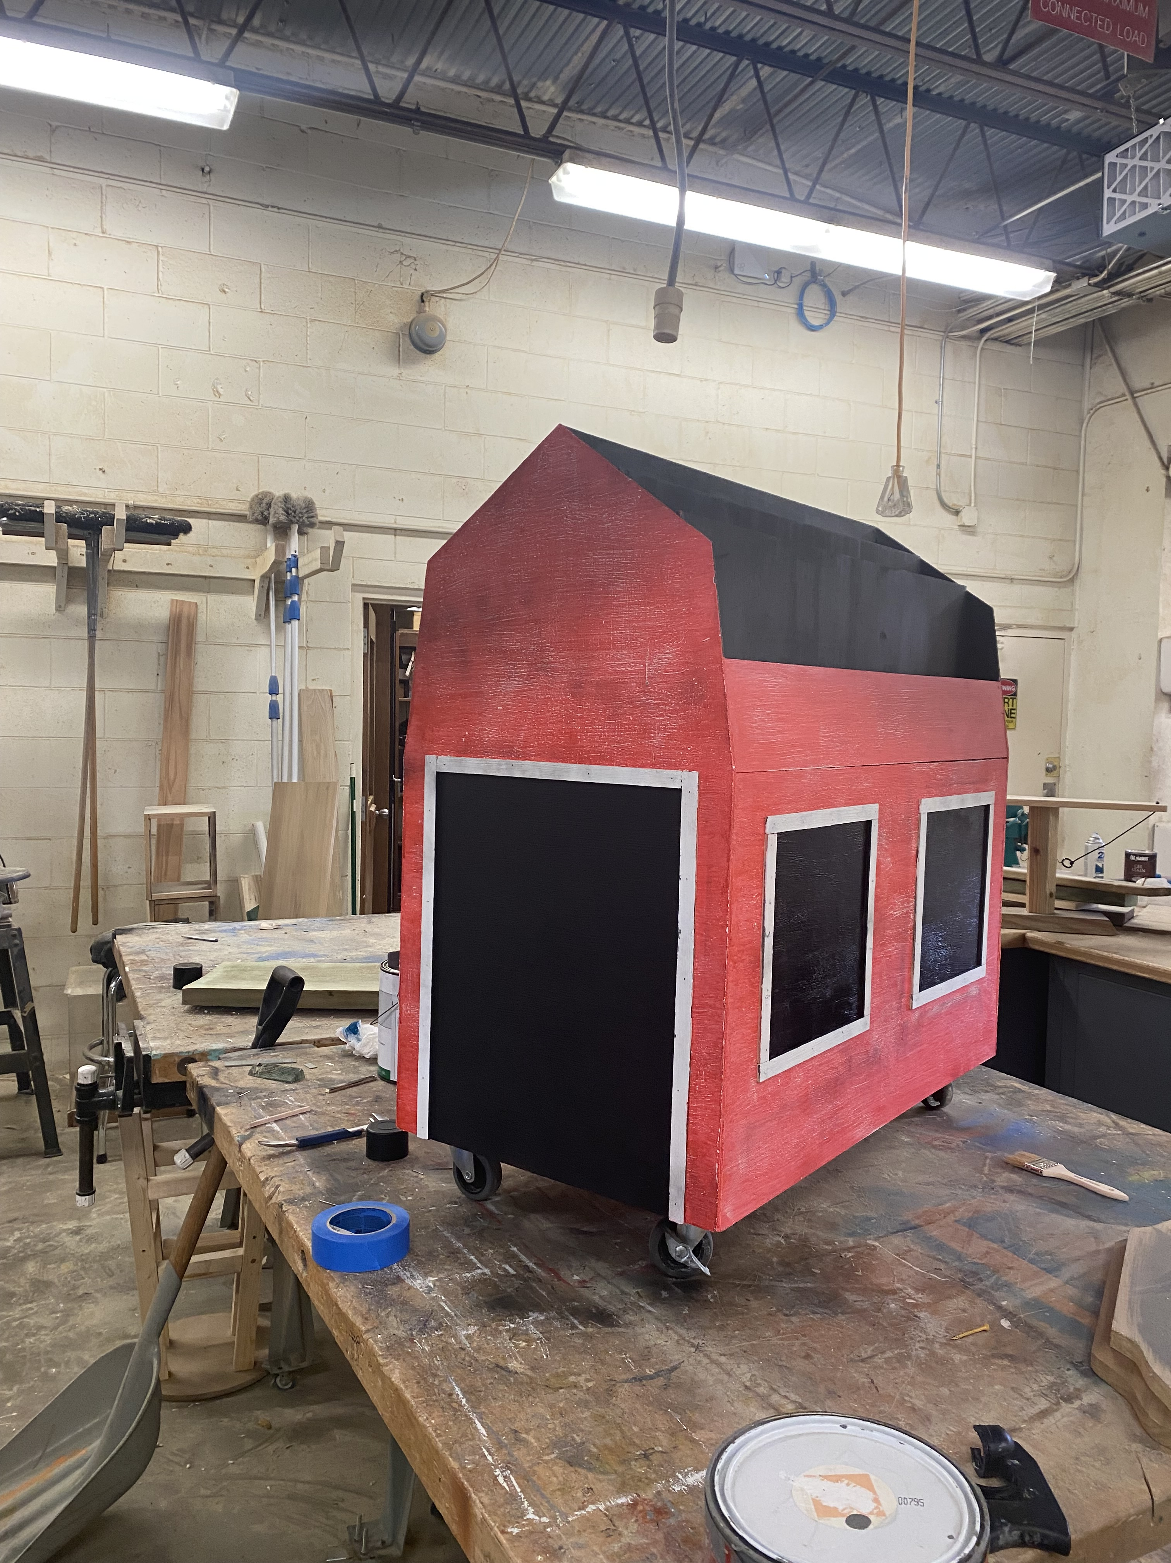
Construction
Completion

Slide 7
Scheduling

Slide 8
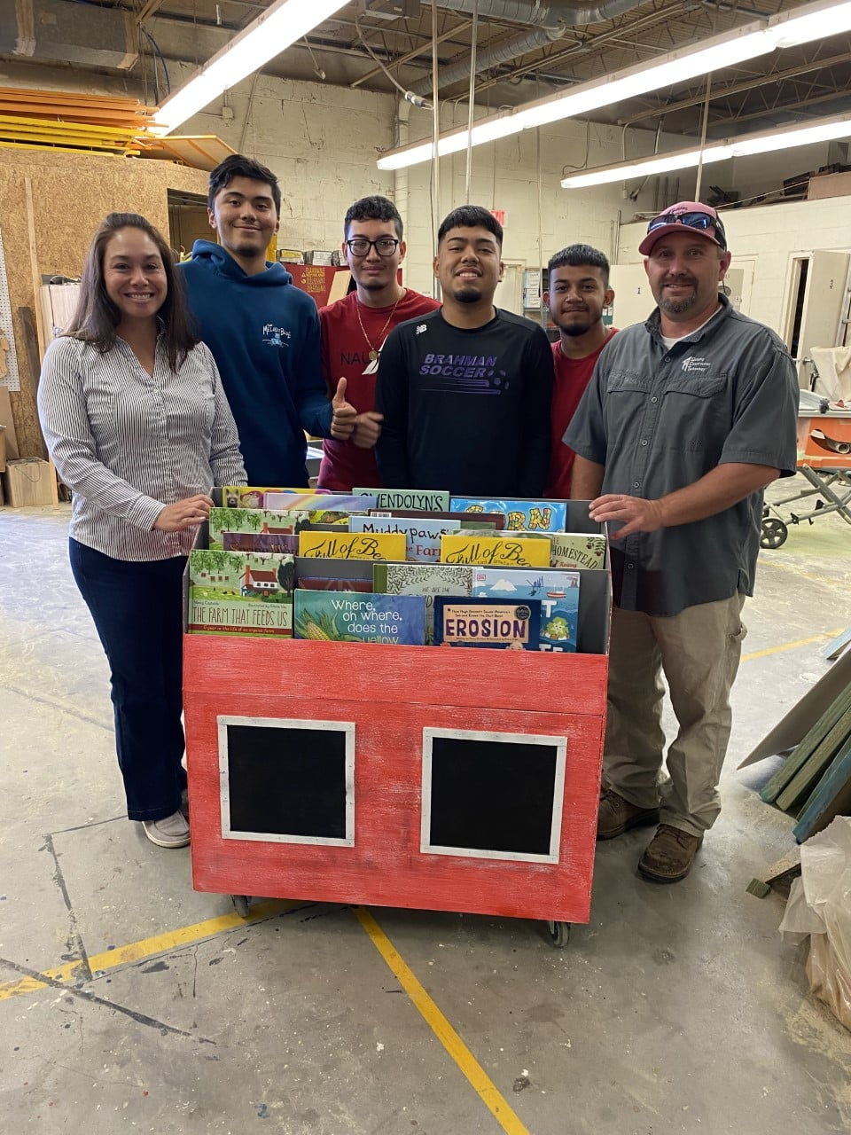
Coming to a school near you!
THANK YOU

