Slide 1
SOUTHEAST CONSERVATION DISTRICT EMPLOYEES' ASSOCIATION
2022 Pigeon Forge TN
Renita (Shorty) Beaty
Urban Conservationist with the Hamilton County Soil & Water Conservation District
Chattanooga TN

Slide 2
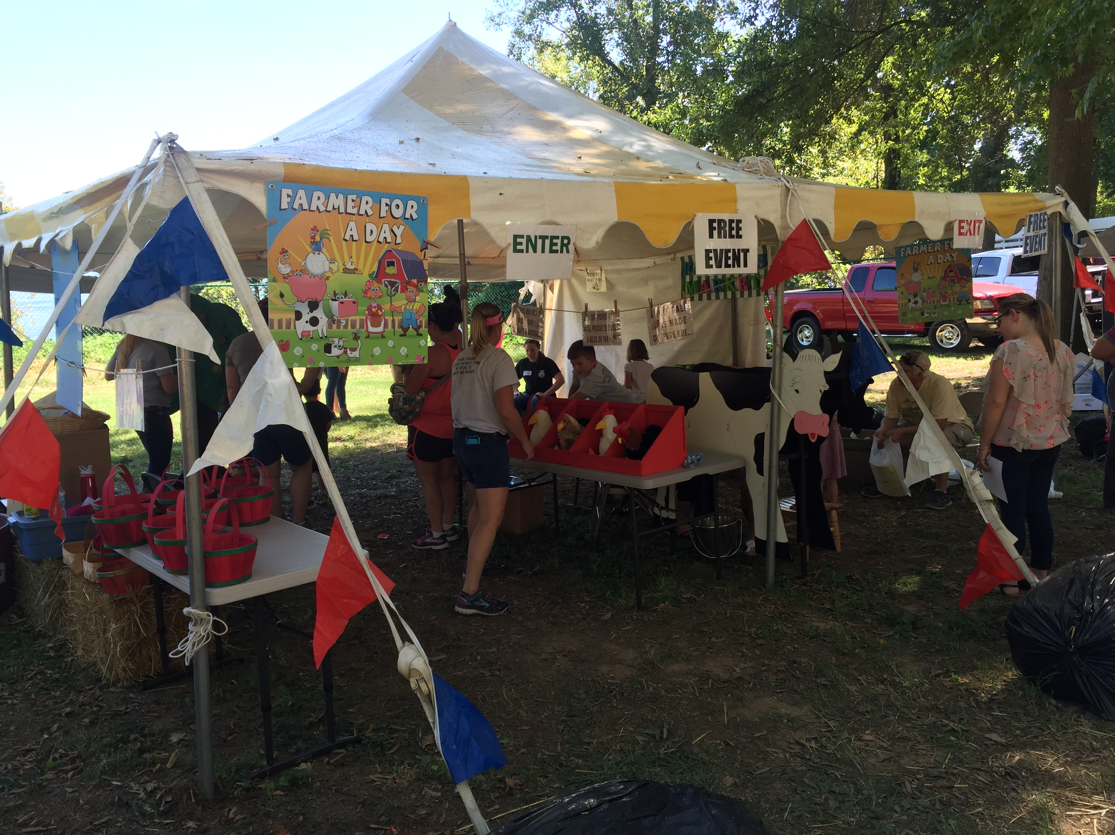
Hamilton County Soil & Water Conservation District
“Farmer
for a Day”

Slide 3
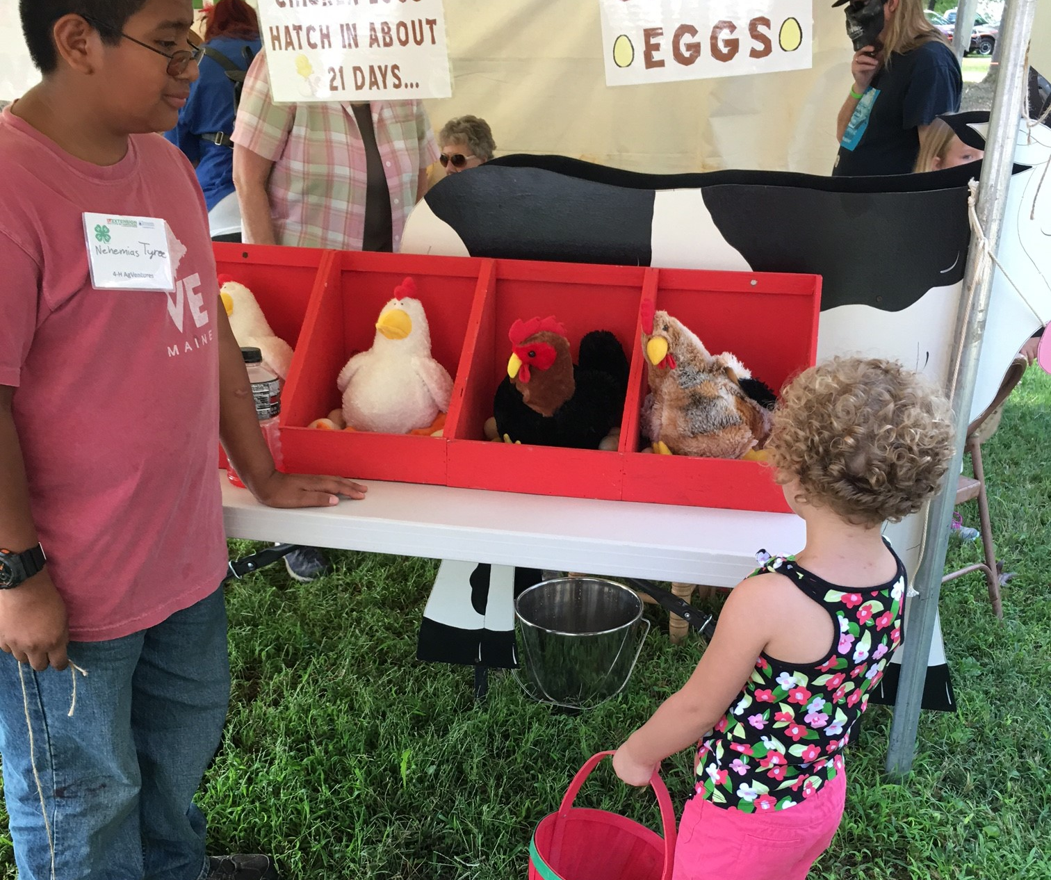
Hamilton County
Soil & Water Conservation District
Grab a locally made basket and let’s get busy harvesting our crops…

Slide 4
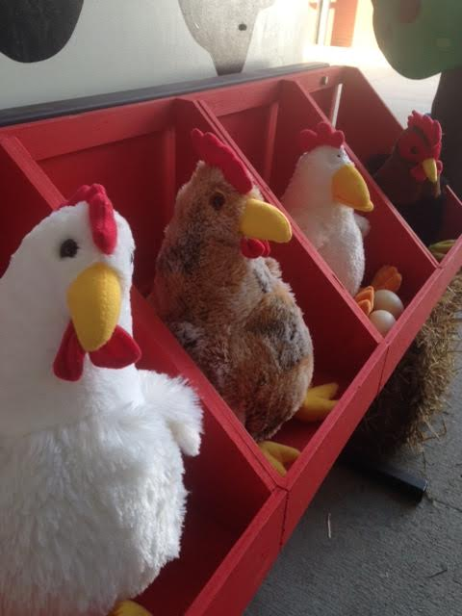

Slide 5
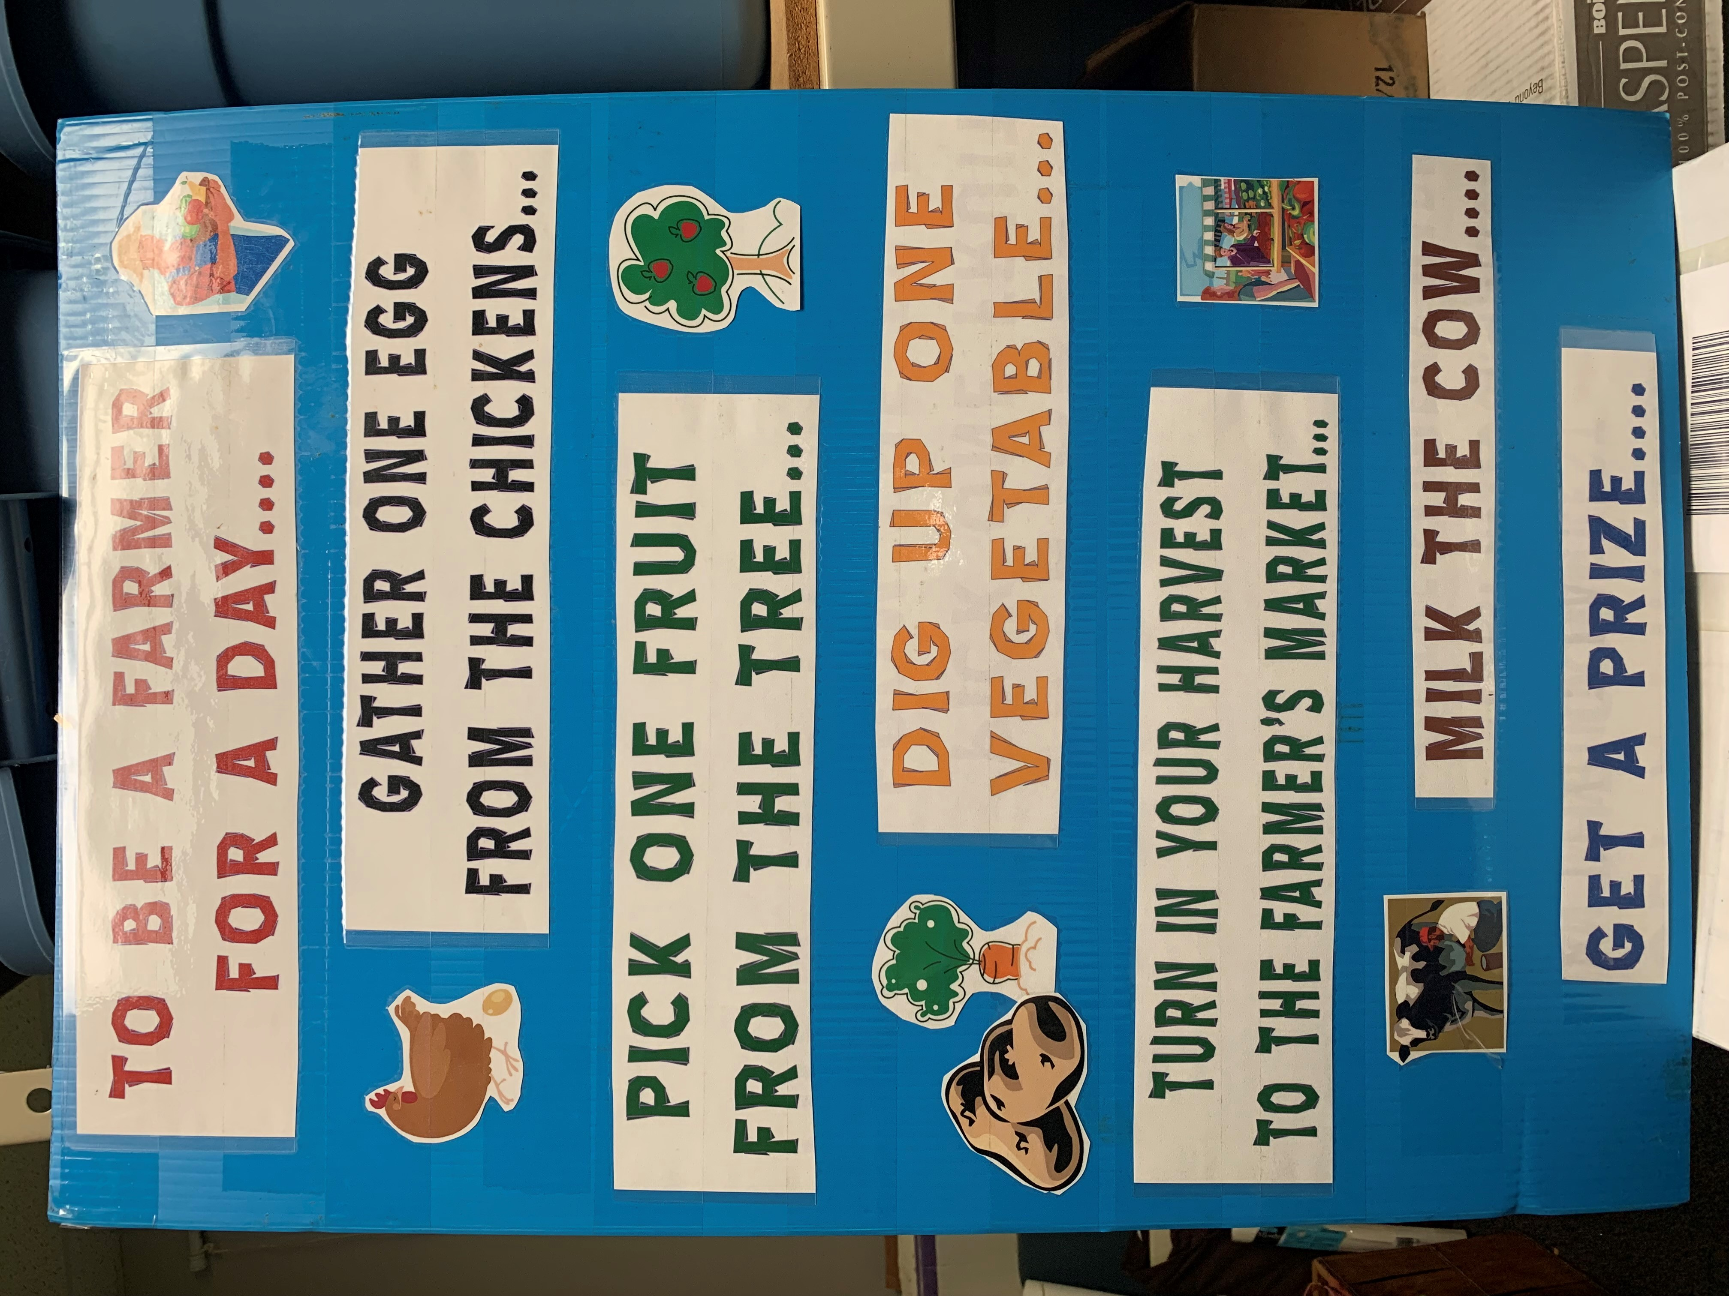
Hamilton County Soil & Water Conservation District
Instruction board –
*get a basket
*gather eggs
*pick fruit
*Dig up a veggie
*Cash in your harvest
*Milk the cow

Slide 6
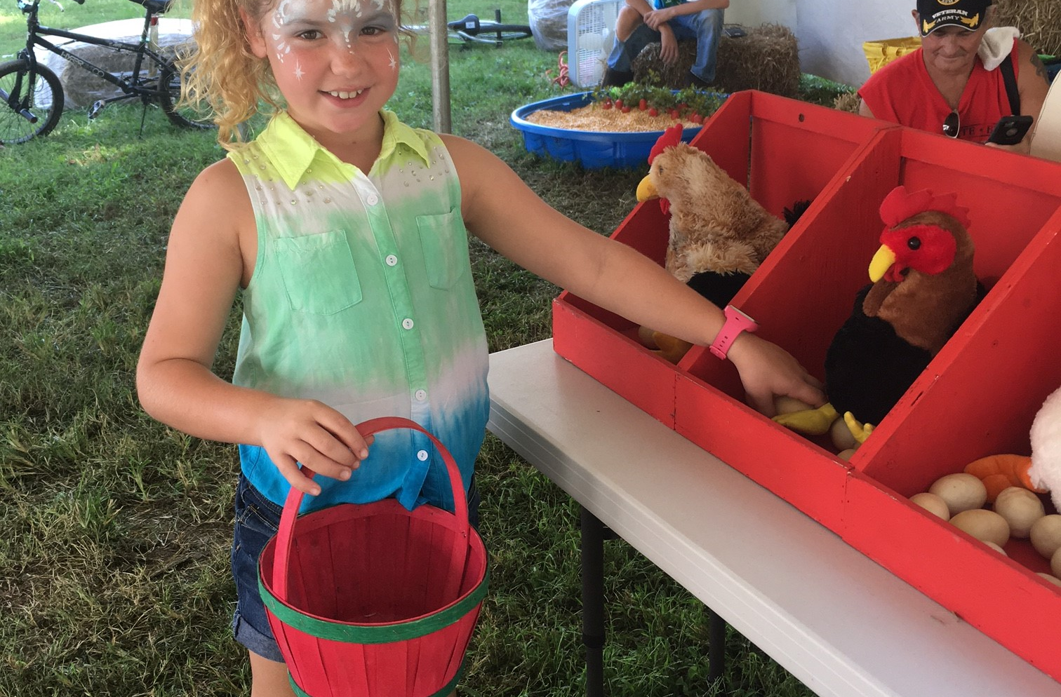
Hamilton County Soil & Water Conservation District
Gathering Eggs Station –
Tractor Supply Co –
Hen boxes
Chickens
Hobby Lobby –
Paper eggs

Slide 7
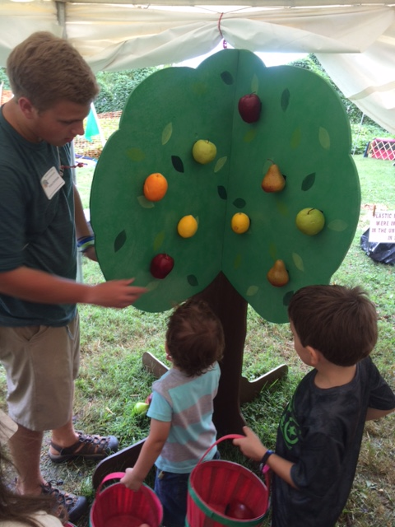
Hamilton County Soil & Water Conservation District
Tree Station -
Gather fruit from the tree-
What color? How many? What kind?
Your teaching –
Colors
Counting
Kinds of fruits

Slide 8
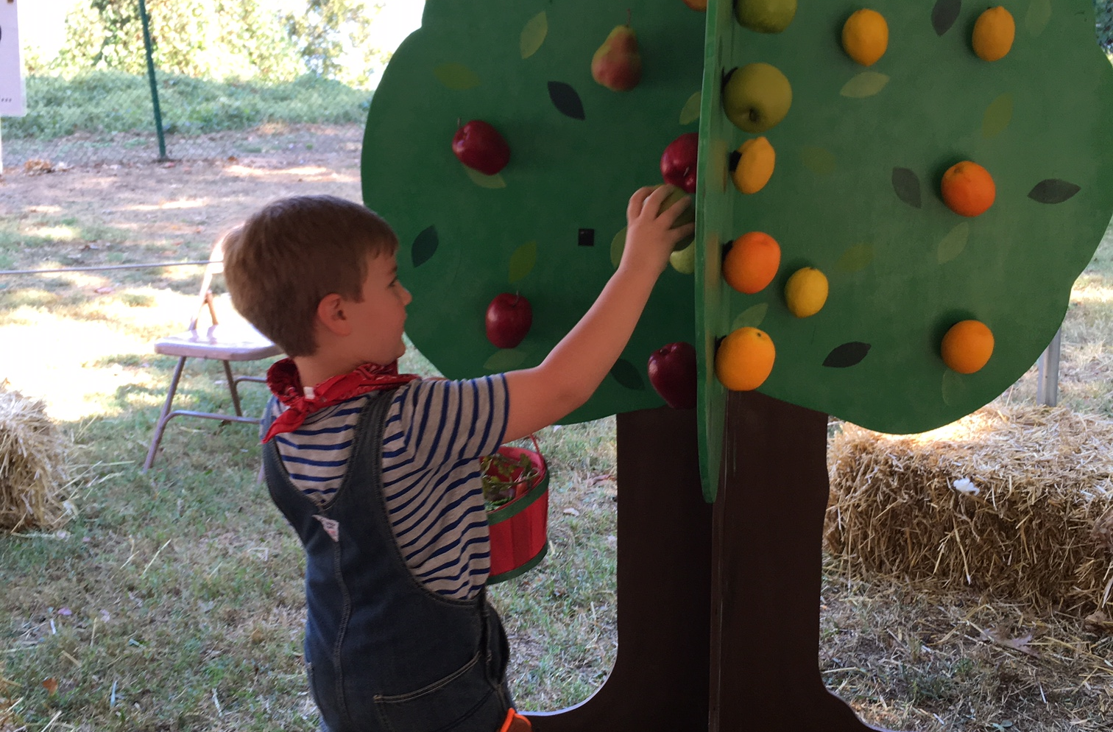
Hamilton County Soil & Water Conservation District
Plywood at the local Ace Hardware -
Tree
Hobby Lobby –
Fruit
Velcro
Paint and Paintbrushes

Slide 9
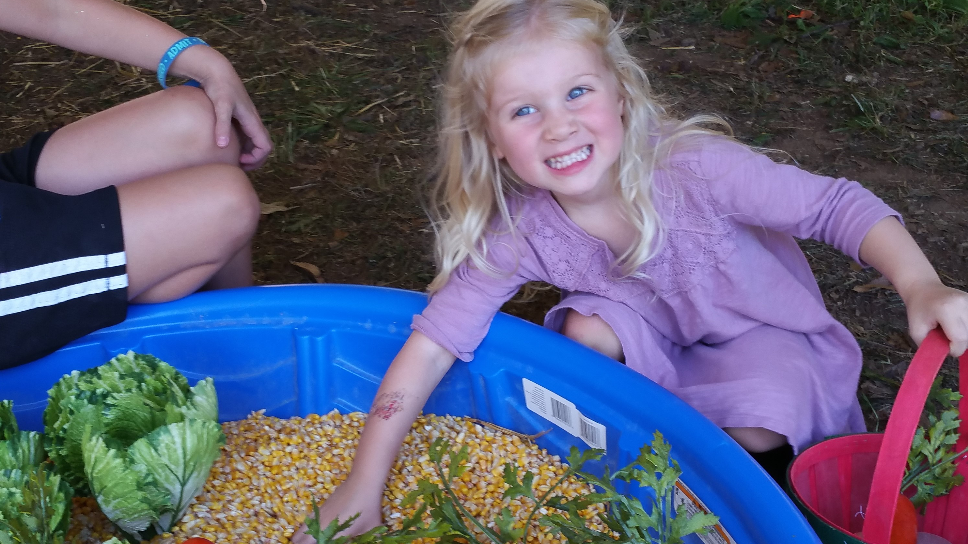
Hamilton County Soil & Water Conservation District
Soil Station -
Dig for Potatoes, Lettuce and Carrots
Teaching – root crops versus leafy greens
Textures, Colors and Numbers

Slide 10
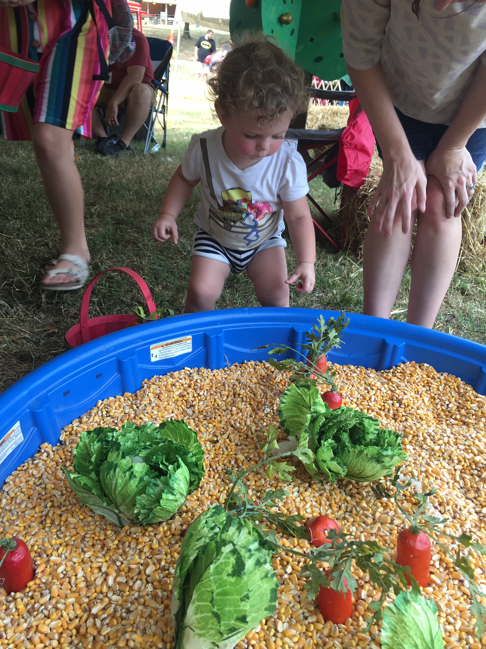
Hamilton County Soil & Water Conservation District
Swimming pool – double layered
Walmart or Dollar General
Feed corn – local coop or feed store
Hobby Lobby or Amazon –
Lettuce and Carrots
Grocery Store –
Real potatoes

Slide 11
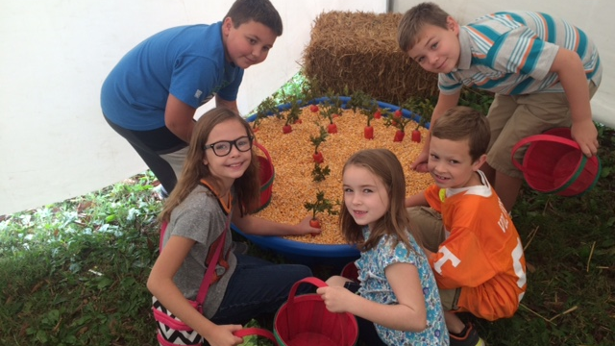

Slide 12

Hamilton County Soil & Water Conservation District
Farmer’s Market
Time to cash your “crops” in and get paid at the Farmer’s Market

Slide 13
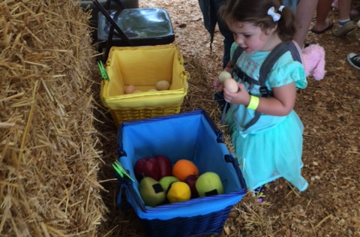
Hamilton County Soil & Water Conservation District
Separate out your crops in the colored baskets ….
Teaching – colors, numbers, root crops, leafy greens, textures…

Slide 14
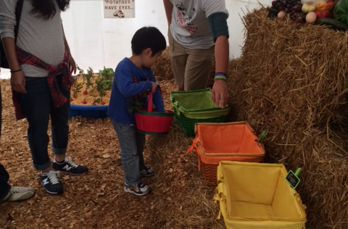
Hamilton County Soil & Water Conservation District
Hobby Lobby –
Colored baskets and clips

Slide 15
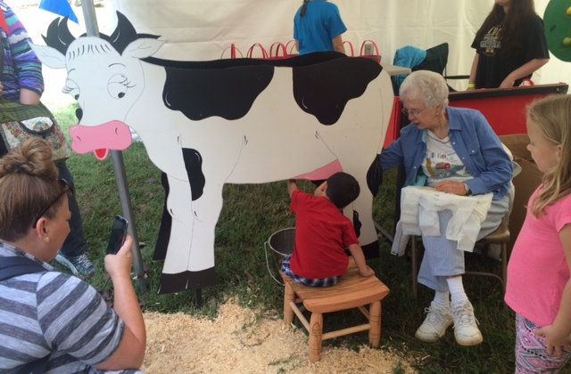
Hamilton County Soil & Water Conservation District
After ‘cashing in their crops”…
Farmers are paid with a Sammy Soil coloring book …
And get to milk the cow…

Slide 16
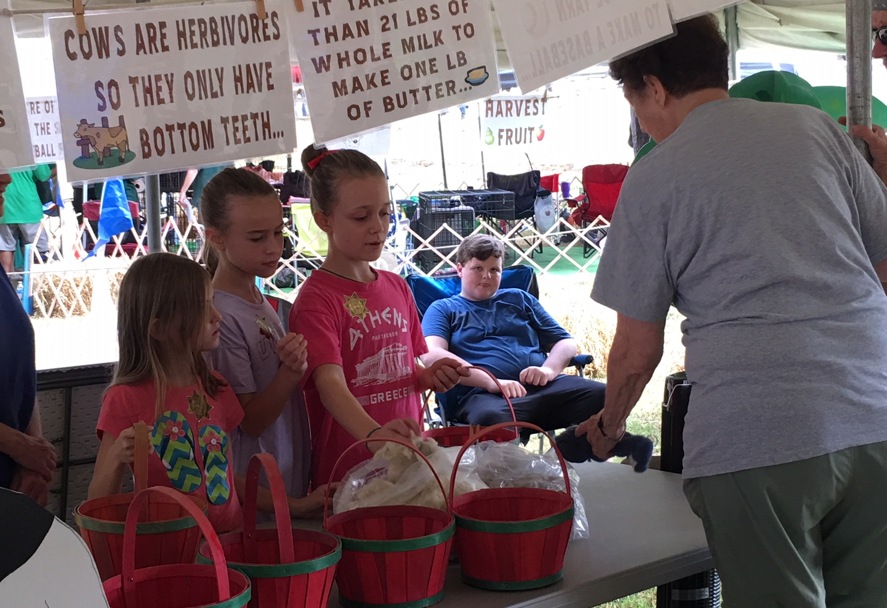
Hamilton County Soil & Water Conservation District
Signage –
We also have signs at each station and all around the tent…
Teaching….
Fun Facts about Farm animals or something about Agriculture…in general…

Slide 17
Hamilton County Soil & Water Conservation District
Examples of some of the signage located around the “Farmer for a Day” tent
Farm Fun Facts
One acre of land is about the size of a football field…
Pigs roll around in the mud to keep cool…
Cows/Bovine are herbivores, so they only have bottom teeth…
One pound of wool produces about 10 miles of yarn...
A baby cow is called a calf...
It takes 450 ft of wool yarn to make a baseball...
A baby sheep is called a lamb...
Potatoes have eyes...
The American Farmer feeds an average of 155 people a day…
A boy chicken is called a rooster…
Crayons are made with soybeans – One acre of soybeans can produce 82,368 crayons…

Slide 18
Hamilton County Soil & Water Conservation District
More examples of some of the signage located around the “Farmer for a Day” tent …
Farm Fun Facts
Plastic milk bottles were introduced in the United States in 1967…
A girl chicken is called a Hen...
A cow has 4 stomachs and 32 teeth….
A hen produces an egg every 23 to 25 hours…
The average dairy cow produces about 7 gallons of milk in a day…
It takes more than 21 pounds of whole milk to make one pound of butter…
Chicken eggs hatch in about 21 days…
So many other fun facts to add….

Slide 19
Hamilton County Soil & Water Conservation District
Some situations are not suited for all the Stations so pending on the situation we might just use a couple of stations …or we change them up…
Example: “Agriculture night” at the Chattanooga Lookouts (minor league ballclub) – because of space we don’t use the swimming pool with the Soil Station, we use a smaller Rubbermaid tub…
Take back what you can use and make it your own…
Just do what stations work for you…

Slide 20
Hamilton County Soil & Water Conservation District
Questions?
Renita (Shorty) Beaty
Urban Conservationist
Hamilton Co Soil & Water
Conservation District
Chattanooga TN

