Slide 2
ENVIROTHON
Franklin County SWCD

Slide 3
TOPICS
AQUATICS
WILDLIFE
SOILS
FORESTRY
CURRENT ISSUE

Slide 4
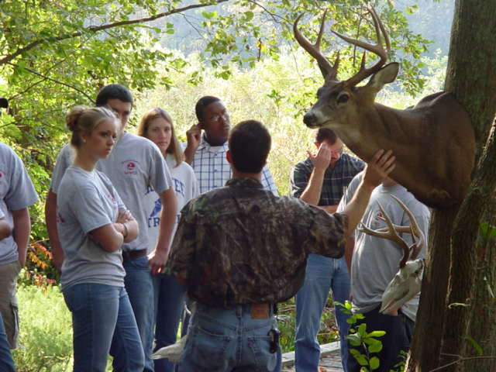
EDUCATION
AQUATICS
WILDLIFE

Slide 5
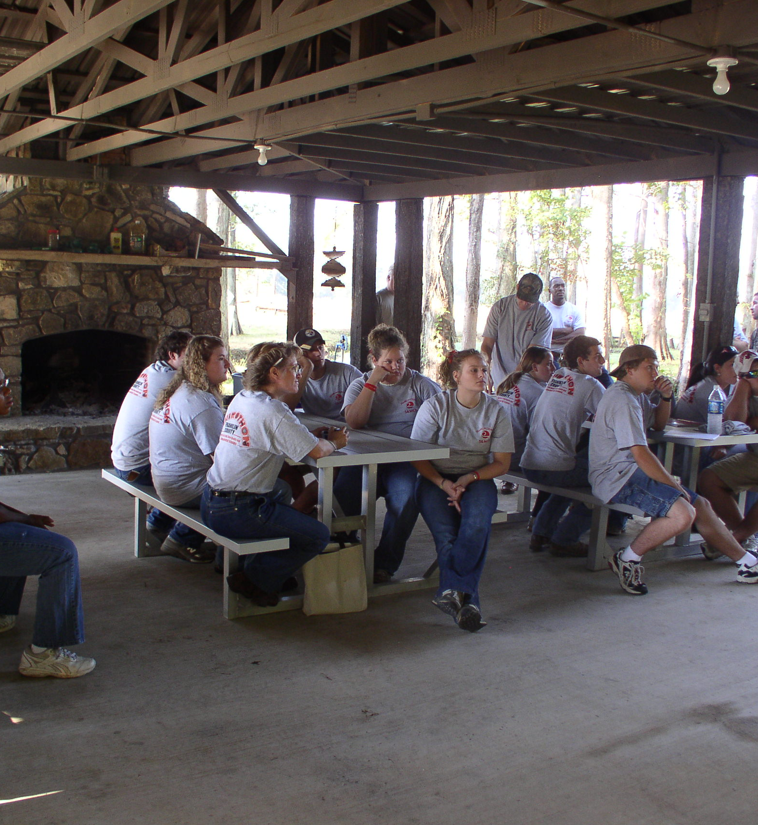
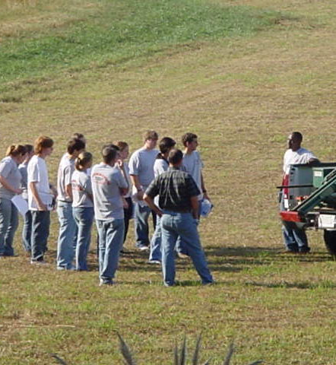
PRESENTATION SKILLS
SOILS

Slide 6
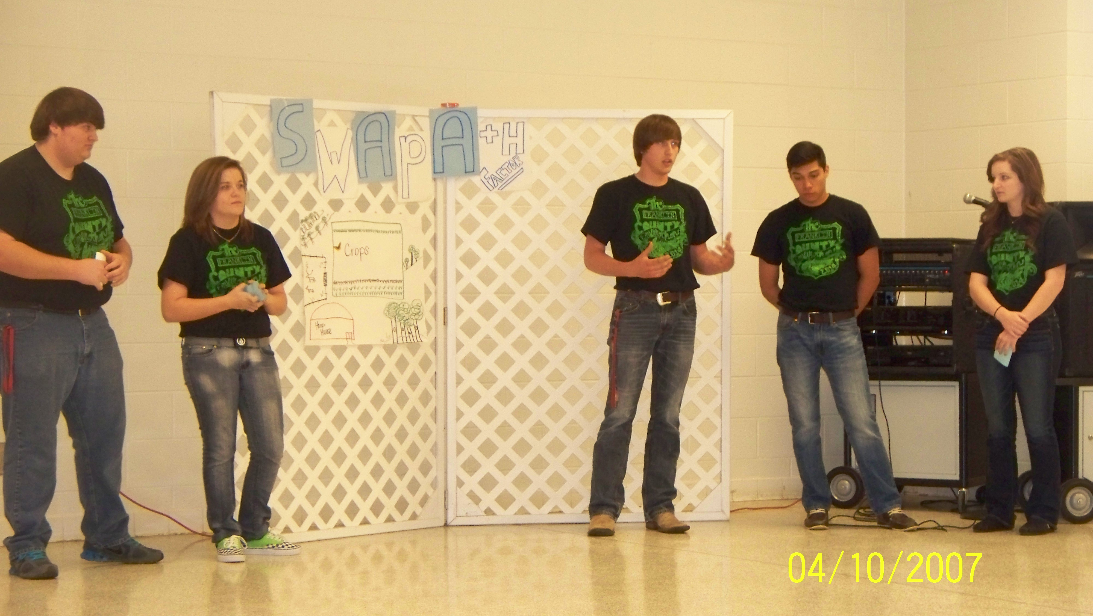
PRESENTATION SKILLS

Slide 7
Franklin County Envirothon History
Franklin County began their Envirothon Program in 1995. We held a two-day Envirothon Event every year until 2020. We held our Envirothon Training on Tuesday and before we could have our testing day that year, we experienced the COVID shut down. We hope to hold a one-day event in 2023.
The Envirothon Competition in Franklin County consist of a training day in which we cover five topics. We have an instructor for aquatics, soils, forestry, wildlife, and a current issue. Each school has a team of five members and one alternate. One student from each school is assigned to train on each topic. At the end of the day, we come together for lunch and a discussion on proper presentation skills.
Our testing/competition day consist of written test and presentations. Each team as a group takes the written test. After these test are completed, the students are presented with the current issue environmental complex problem. They are given an hour to prepare their presentation and come up with their solution, as a team, for that environmental problem. A team of judges will score the presentations based on participation, presentation skills, and the solution given for the problem.
At the end of the competition three winners are awarded. The top two teams are sponsored to compete in the state competition and hopefully the nationals.

